Slide 1
KeyStone SoC Architecture Overview
KeyStone Training
Multicore Applications
Literature Number: SPRP816

Slide 2
Agenda
KeyStone I Architecture
CorePac & Memory Subsystem
Internal Communications and Transport
External Interfaces
Coprocessors and Accelerators
Miscellaneous
KeyStone II Architecture
ARM Cortex-A15 CorePac
Performance/Throughput Improvements
KeyStone Platform
Debug
Device-Specific Offerings
Notes:
NEW

Slide 3
KeyStone I Architecture
CorePac & Memory Subsystem
Internal Communications and Transport
External Interfaces
Coprocessors and Accelerators
Miscellaneous

Slide 4
KeyStone I Device Architecture
Memory Subsystem
Application-Specific
Coprocessors
C66x™
CorePac
Miscellaneous
HyperLink
TeraNet
Multicore Navigator
External Interfaces
Network Coprocessor
Notes:
4
NEW

Slide 5
KeyStone I CorePac
Memory Subsystem
Application-Specific
1 to 8 C66x CorePac DSP Cores operating at up to 1.25 GHz
Fixed- and floating-point operations
Code compatible with other C64x+ and C67x+ devices
L1 Memory
Can be partitioned as cache and/or RAM
32KB L1P per core
32KB L1D per core
Error detection for L1P
Memory protection
Dedicated L2 Memory
Can be partitioned as cache and/or RAM
512 KB to 1 MB Local L2 per core
Error detection and correction for all L2 memory
Direct connection to memory subsystem
Coprocessors
C66x™
CorePac
L1P
L1D
Cache/RAM
Cache/RAM
L2 Memory Cache/RAM
Miscellaneous
1 to 8 Cores @ up to 1.25 GHz
HyperLink
TeraNet
Multicore Navigator
External Interfaces
Network Coprocessor
Notes:
5
NEW

Slide 6
KeyStone I Memory Subsystem
Application-Specific
Multicore Shared Memory (MSM SRAM)
1 to 4 MB
Available to all cores
Can contain program and data
All devices except C6654
Multicore Shared Memory Controller (MSMC)
Arbitrates access of CorePac and SoC masters to shared memory
Provides a connection to the DDR3 EMIF
Provides CorePac access to coprocessors and IO peripherals
Provides error detection and correction for all shared memory
Memory protection and address extension to 64 GB (36 bits)
Provides multi-stream pre-fetching capability
DDR3 External Memory Interface (EMIF)
Support for 16-bit, 32-bit, and (for C667x devices) 64-bit modes
Specified at up to 1600 MT/s
Supports power down of unused pins when using 16-bit or 32-bit width
Support for 8 GB memory address
Error detection and correction
Memory Subsystem
Coprocessors
DDR3 EMIF
MSM
SRAM
MSMC
C66x™
CorePac
L1P
L1D
Cache/RAM
Cache/RAM
L2 Memory Cache/RAM
Miscellaneous
1 to 8 Cores @ up to 1.25 GHz
HyperLink
TeraNet
Multicore Navigator
External Interfaces
Network Coprocessor
Notes:
6
NEW

Slide 7
Enhanced DMA: EDMA3 1D Transfer
1D transfer is used to move a vector.

Slide 8
EDMA3: 2D Transfer
2D transfer is used to move a matrix; That is, to share a frame between multiple cores.

Slide 9
EDMA3: 3D Transfer
3D transfer is used to move multiple matrices. That is, to share frames between multiple cores.

Slide 10
EDMA3: Transfer 2D Destination
It is faster to have strides in SRAM (like L2) than in DDR, so that it reads a complete line and distributes between L2 memories.

Slide 11
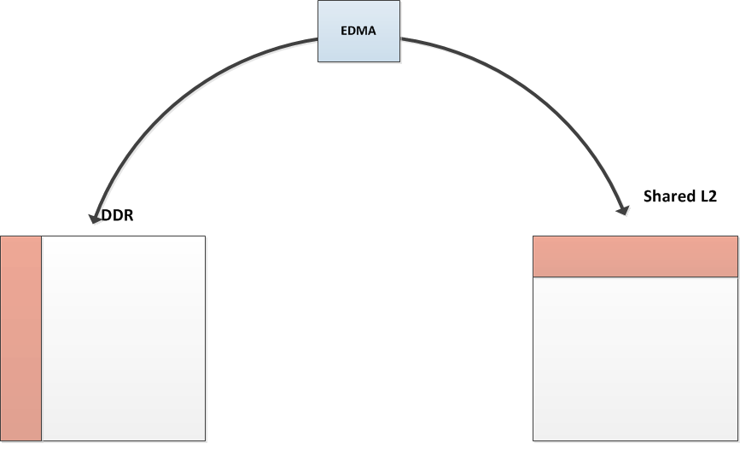
EDMA3: Source and Destination
Matrix transport is used to turn rows into columns.
Based on the direction, use 2D in the source (Shared L2 to DDR) or the destination (DDR to Shared L2).

Slide 12
KeyStone I Multicore Navigator
Provides seamless inter-core communications (messages and data exchanges) between cores, IP, and peripherals. “Fire and forget”
Low-overhead processing and routing of packet traffic to and from peripherals and cores
Supports dynamic load optimization
Data transfer architecture designed to minimize host interaction while maximizing memory and bus efficiency
Consists of a Queue Manager Subsystem (QMSS) and multiple, dedicated Packet DMA (PKTDMA) engines
Memory Subsystem
Application-Specific
MSM
Coprocessors
DDR3 EMIF
SRAM
MSMC
C66x™
CorePac
L1P
L1D
Cache/RAM
Cache/RAM
L2 Memory Cache/RAM
Miscellaneous
1 to 8 Cores @ up to 1.25 GHz
HyperLink
TeraNet
Multicore Navigator
Queue
Packet
Manager
DMA
External Interfaces
Network Coprocessor
Notes:
12
NEW

Slide 13
KeyStone I Network Coprocessor
Application-Specific
Provides hardware accelerators to perform L2, L3, and L4 processing and encryption that was previously done in software
Packet Accelerator (PA)
Single or multiple IP address option
UDP (and TCP) checksum and selected CRCs
L2/L3/L4 support
Quality of Service (QoS)
Multicast to multiple destinations inside the device
Timestamps
Security Accelerator (SA)
Hardware encryption, decryption, and authentication
Supports IPsec ESP, IPsec AH, SRTP, and 3GPP protocols
Memory Subsystem
Coprocessors
DDR3 EMIF
MSM
SRAM
MSMC
C66x™
CorePac
L1P
L1D
Cache/RAM
Cache/RAM
L2 Memory Cache/RAM
Miscellaneous
1 to 8 Cores @ up to 1.25 GHz
HyperLink
TeraNet
Multicore Navigator
Queue
Packet
Manager
DMA
t
e
h
n
c
Security
r
t
h
External Interfaces
e
i
c
h
w
t
Accelerator
t
S
i
E
w
S
Packet
I
Accelerator
I
M
x2
G
S
Network Coprocessor
Notes:
13
NEW

Slide 14
KeyStone I External Interfaces
Memory Subsystem
Application-Specific
2x SGMII ports support 10/100/1000 Ethernet
4x high-bandwidth Serial RapidIO (SRIO) lanes
2x PCIe at 5 Gbps
SPI for boot operations
UART for development/testing
I2C for EPROM at 400 Kbps
GPIO
Device-specific Interfaces
Wireless Applications
General Purpose Applications
MSM
Coprocessors
DDR3 EMIF
SRAM
MSMC
C66x™
CorePac
L1P
L1D
Cache/RAM
Cache/RAM
L2 Memory Cache/RAM
Miscellaneous
1 to 8 Cores @ up to 1.25 GHz
HyperLink
TeraNet
Multicore Navigator
Queue
Packet
Manager
DMA
x2
x4
t
T
e
h
C
R
I
n
c
Security
e
P
O
r
t
h
Device Specific I/O
A
Device Specific I/O
e
i
c
GPIO
2
I
S
I
C
U
I
h
w
t
Accelerator
P
R
t
S
i
S
E
w
S
Packet
I
Accelerator
I
M
x2
G
S
Network Coprocessor
Notes:
14
NEW

Slide 15
TeraNet Switch Fabric
Memory Subsystem
Application-Specific
A non-blocking switch fabric that enables fast and contention-free internal data movement
Provides a configured way – within hardware – to manage traffic queues and ensure priority jobs are getting accomplished while minimizing the involvement of the CorePac cores
Facilitates high-bandwidth communications between CorePac cores, subsystems, peripherals, and memory
MSM
Coprocessors
DDR3 EMIF
SRAM
MSMC
C66x™
CorePac
L1P
L1D
Cache/RAM
Cache/RAM
L2 Memory Cache/RAM
Miscellaneous
1 to 8 Cores @ up to 1.25 GHz
HyperLink
TeraNet
Multicore Navigator
Queue
Packet
Manager
DMA
x2
x4
t
T
e
h
C
R
I
n
c
Security
e
P
O
r
t
h
Device Specific I/O
A
Device Specific I/O
e
i
c
GPIO
2
I
S
I
C
U
I
h
w
t
Accelerator
P
R
t
S
i
S
E
w
S
Packet
I
Accelerator
I
M
x2
G
S
Network Coprocessor
Notes:
15
NEW

Slide 16
KeyStone I TeraNet Data Connections
HyperLink
S
MSMC
DDR3
S
M
CPUCLK/2
256bit TeraNet
Shared L2
S
HyperLink
DDR3
M
S
S
S
S
M
TPCC
16ch QDMA
TC0
M
EDMA_0
TC1
M
Facilitates high-bandwidth communication links between DSP cores, subsystems, peripherals, and memories.
Supports parallel orthogonal communication links
XMC
S
L2 0-3
M
SRIO
S
Core
M
M
S
Core
M
M
S
Core
M
Network
Coprocessor
M
SRIO
TPCC
64ch
QDMA
TC2
M
S
TC3
M
S
TPCC
64ch
QDMA
TC6
M
TCP3e_W/R
TC4
M
TC5
TC7
M
M
TC8
M
TC9
M
S
EDMA_1,2
TCP3d
S
CPUCLK/3
128bit TeraNet
TCP3d
TAC_BE
TAC_FE
S
M
RAC_FE
RAC_BE0,1
S
M
RAC_FE
RAC_BE0,1
S
M
FFTC / PktDMA
M
FFTC / PktDMA
M
VCP2 (x4)
S
VCP2 (x4)
S
VCP2 (x4)
AIF / PktDMA
S
M
VCP2 (x4)
S
QMSS
M
QMSS
PCIe
S
M
S
PCIe
DebugSS
M
Notes:
CPT see physical addresses. In MSMC, one CPT per bank.

Slide 17
KeyStone I HyperLink Bus
Memory Subsystem
Application-Specific
Provides the capability to expand the device to include hardware acceleration or other auxiliary processors
Supports four lanes with up to 12.5 Gbaud per lane
MSM
Coprocessors
DDR3 EMIF
SRAM
MSMC
Debug/Trace
C66x™
CorePac
L1P
L1D
Cache/RAM
Cache/RAM
L2 Memory Cache/RAM
Miscellaneous
1 to 8 Cores @ up to 1.25 GHz
HyperLink
TeraNet
Multicore Navigator
Queue
Packet
Manager
DMA
x2
x4
t
T
e
h
C
R
I
n
c
Security
e
P
O
r
t
h
Device Specific I/O
A
Device Specific I/O
e
i
c
GPIO
2
I
S
I
C
U
I
h
w
t
Accelerator
P
R
t
S
i
S
E
w
S
Packet
I
Accelerator
I
M
x2
G
S
Network Coprocessor
Notes:
17
NEW

Slide 18
KeyStone I Miscellaneous Elements
Memory Subsystem
Application-Specific
Boot ROM
Semaphore module provides atomic access to shared chip-level resources.
Power Management
Three on-chip PLLs:
PLL1 for CorePacs, except
PLL2 for DDR3
PLL3 for Packet Acceleration
Three EDMA controllers
Eight 64-bit timers
Inter-Processor Communication (IPC) Registers
MSM
Coprocessors
DDR3 EMIF
SRAM
MSMC
Debug/Trace
Boot ROM
Semaphore
C66x™
Power
CorePac
Management
PLL
L1P
L1D
x3
Cache/RAM
Cache/RAM
EDMA
L2 Memory Cache/RAM
x3
1 to 8 Cores @ up to 1.25 GHz
HyperLink
TeraNet
Multicore Navigator
Queue
Packet
Manager
DMA
x2
x4
t
T
e
h
C
R
I
n
c
Security
e
P
O
r
t
h
Device Specific I/O
A
Device Specific I/O
e
i
c
GPIO
2
I
S
I
C
U
I
h
w
t
Accelerator
P
R
t
S
i
S
E
w
S
Packet
I
Accelerator
I
M
x2
G
S
Network Coprocessor
Notes:
18
NEW

Slide 19
KeyStone Central Interrupt Controller
CIC0
C66x CorePac0
C66x CorePac1
C66x CorePac2
C66x CorePac3
CIC1
C66x CorePac4
C66x CorePac5
Events
C66x CorePac6
C66x CorePac7
CIC2
HyperLink
EDMA CC0
EDMA CC1
EDMA CC2
EDMA CC3
EDMA CC4
Peripherals
ARM A15
CorePac
Notes:
19
3 interrupt controllers each one connected to specific corePacs or peripherals in the system. Apart from each corePac have a interrupt controller we have a centralized controleer to map events generated in one block to another block in the system.

Slide 20
Diagnostic Enhancements
Memory Subsystem
Application-Specific
Embedded Trace Buffers (ETB) enhance the diagnostic capabilities of the CorePac.
CP Monitor enables diagnostic capabilities on data traffic through the TeraNet switch fabric.
Automatic statistics collection and exporting (non-intrusive)
Monitor individual events for better debugging
Monitor transactions to both memory end point and Memory-Mapped Registers (MMR)
Configurable monitor filtering capability based on address and transaction type
MSM
Coprocessors
DDR3 EMIF
SRAM
MSMC
Debug/Trace
C66x™
CorePac
L1P
L1D
Cache/RAM
Cache/RAM
L2 Memory Cache/RAM
Miscellaneous
1 to 8 Cores @ up to 1.25 GHz
HyperLink
TeraNet
Multicore Navigator
Queue
Packet
Manager
DMA
x2
x4
t
T
e
h
C
R
I
n
c
Security
e
P
O
r
t
h
Device Specific I/O
A
Device Specific I/O
e
i
c
GPIO
2
I
S
I
C
U
I
h
w
t
Accelerator
P
R
t
S
i
S
E
w
S
Packet
I
Accelerator
I
M
x2
G
S
Network Coprocessor
Notes:
20
NEW

Slide 21
KeyStone II Architecture
ARM Cortex-A15 CorePac
Performance/Throughput Improvements

Slide 22
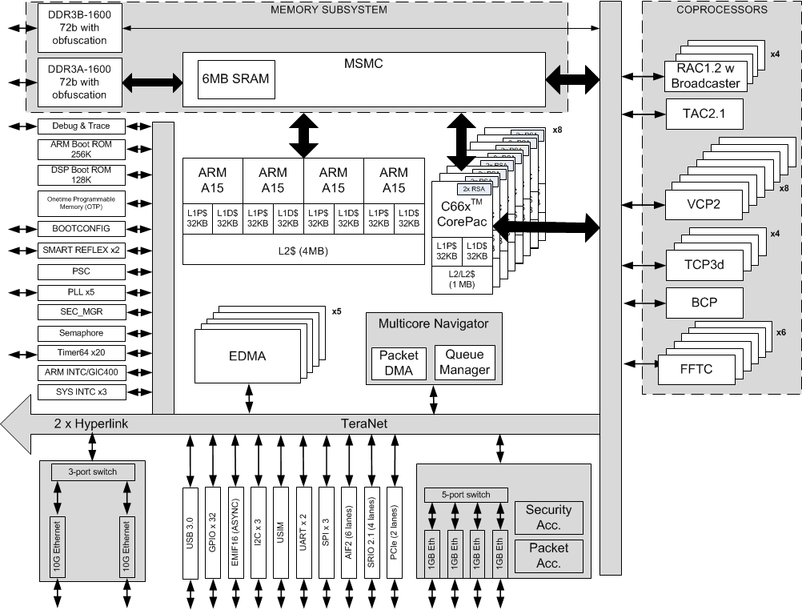
Keystone II Architecture Example

Slide 23
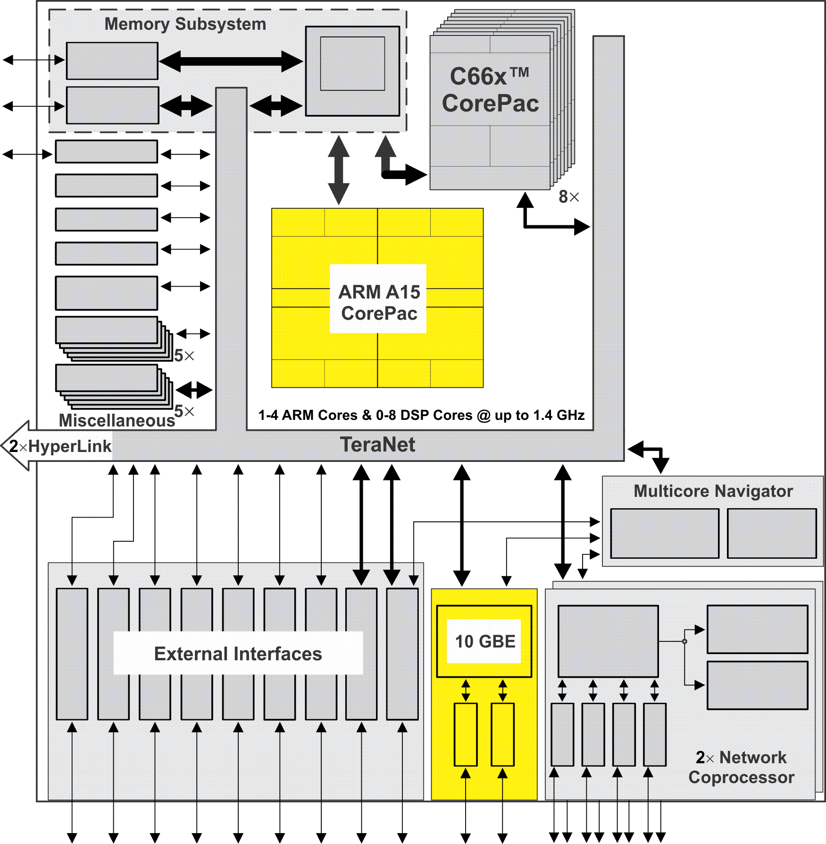
KeyStone II Device Architecture
C66x CorePac
ARM A15 CorePac
Memory Subsytem
Multicore Navigator
Network Coprocessor
TeraNet Switch Fabric
10 Gigabit Ethernet (10 GBE)
External Interfaces
HyperLink Bus
Miscellaneous
Notes:
23
We added ARM A15 Core into the mix.
This helps the customer to implement additional blocks of their system.
This integration helps them to reduce the power foot print of the system and also able to provide a cheaper solution by reducing a bill of materials.
Another key addition is the 10 Giga bit ethernet SS that can help to provide high packet based data rate.
As we move along opening these blocks we can also see that we increased the instances of some of these peripherals to further enhance the SoC experience for the customers.
Also as we proceed through the presentation, I will emphasize on some key design features or enhancements that we made in KS II as opposed to KS I.

Slide 24
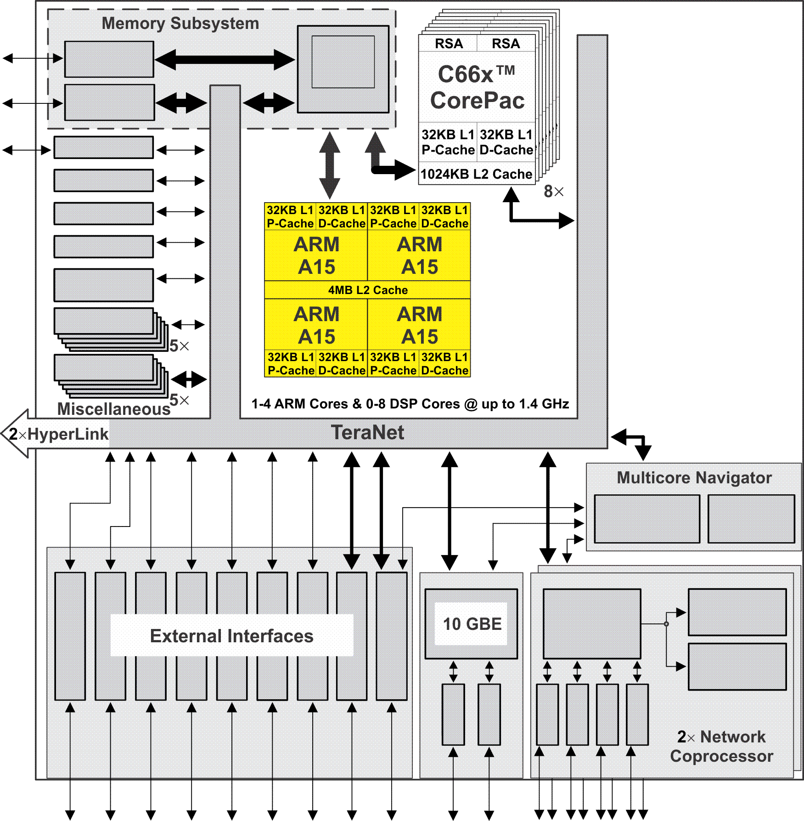
ARM Cortex-A15 CorePac
Single, Dual, or Quad-ARM A15 CorePac operating at up to 1.4 GHz.
Full implementation of ARMv7-A architecture instruction set
Integrated Neon and Vector Floating-Point Unit
L1 Memory: 32KB L1 per ARM A15 for caching program and data
L2 Memory:
Shared L2 Cache Memory with full cache coherency using Snoop Control Unit (SCU)
4 MB L2 Cache is shared between the 1 to 4 ARM A15 core(s).
The AMBA 4.0 AXI Coherency Extension (ACE) master port is connected directly to the MSMC2 for short-path access to shared MSMC SRAM.
The ACE also provides IO-coherent access to the shared memory and external memory connected through the EMIF.
Cluster-level and core-level power management and low-power standby modes (also known as WFI/WFE modes)
Notes:
24
Contains an ARM cluster with one, two or 4 ARMs in it.
Running at 1.4GHz.
Two levels of memory just like DSP.
But L2 is shared for cache coherency.
Connected to the MSMC through ACE also provided cachec coherency with other peripheral masters.
Power management.(Wait for Interrupt/ Wait for Event).
BootROM.

Slide 25
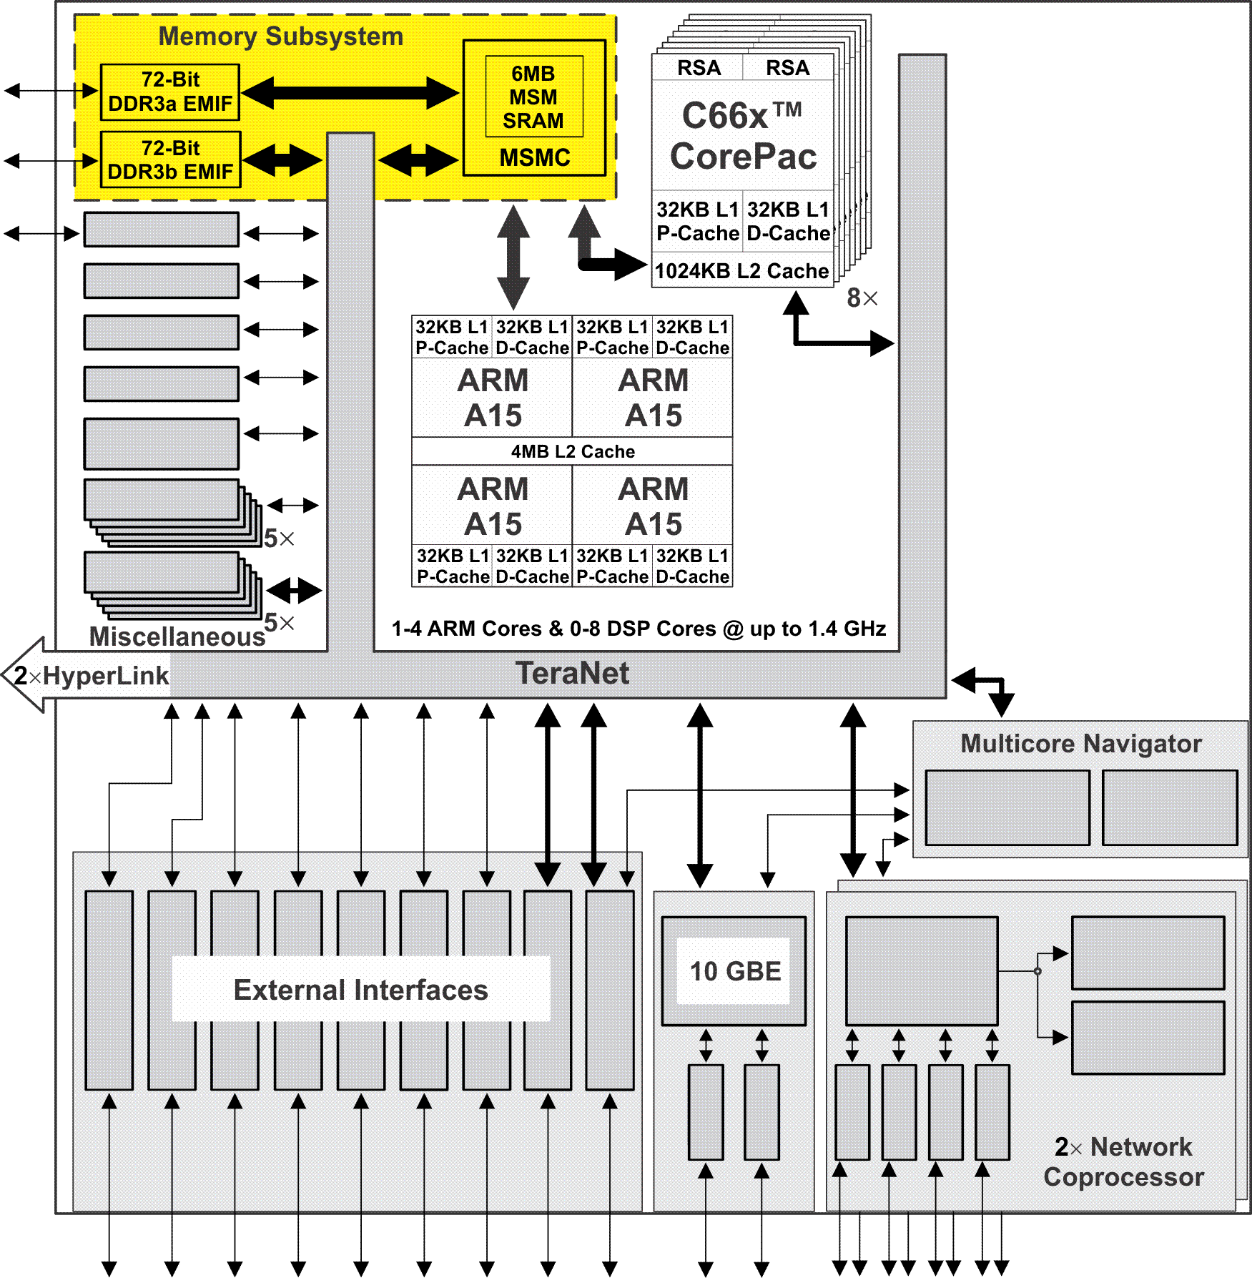
KeyStone II Memory Subsystem: MSM/MSMC
Multicore Shared Memory (MSM SRAM)
2-6 MB shared among the C66x and ARM A15 CorePacs.
May contain program and data
Multicore Shared Memory Controller (MSMC version 2.0)
Arbitrates access of C66x and ARM A15 CorePac and SoC masters to shared and external memory through DDR3 EMIF
Provides error detection and correction for all shared memory
Memory protection and address extension to 64 GB (36 bits)
Provides multi-stream pre-fetching capability
Support for ARM coherency with EDMA/peripheral masters in DDR3A and MSMC SRAM space
8 SRAM banks
Runs at the DSP frequency, thereby increasing memory access by fourfold compared to previous MSMC v1.0
Notes:
25
MSMC is another block in the architecture which got a face lift in KS II.
Increased the SRAM in some devices to 6MB.
Also this memory is shared across DSP and ARM.
MSMC controller provides access to the DDR3 through EMIF.
Address extension to 64GB.
ARM cache coherency with EDMA and peripheral masters.
Depending of the device variation we have 2 – 8 SRAM banks.
Key improvement is CPU/1 frequency.

Slide 26
KeyStone II Memory Subsystem: DDR3
Up to two DDR3 subsystem(s) per device:
The first DDR3 subsystem (DDR3A) supports up to 8 GB memory addresses and is connected to the CorePac(s) through the MSMC.
When present, the second DDR3 subsystem (DDR3B) supports up to 2GB memory address and is connected directly to the TeraNet.
Each DDR consists of a 64b/72b EMIF controller:
Supports 16-bit, 32-bit, and 64-bit modes .
Operates at up to 1600 MT/s
Supports power down of unused pins when using 16-bit or 32-bit width
Notes:
26
Based on the device selected, we might have 1 or 2 DDR3 interface.
First DDR3 interface supports 8GB
Second DDR3 interface supports 2GB
Each interface is 72b EMIF controller with 8b EC.
Separate access for ARM and peripheral masters and also provides additional bandwidth.
No Cache coherency in the second DDR3 interface.

Slide 27
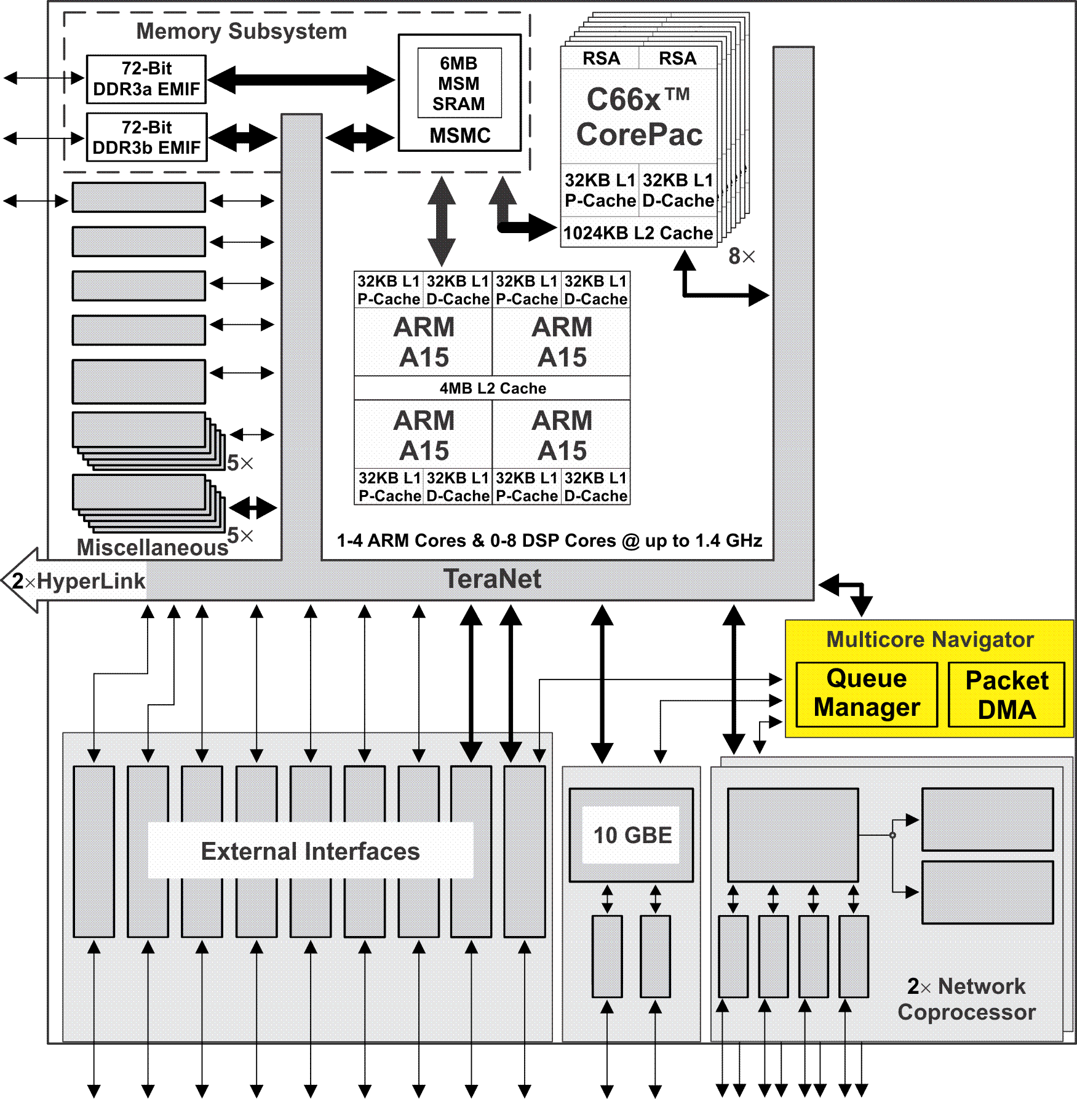
KeyStone II Multicore Navigator
Consists of the following:
2x Queue Manager
Multiple, dedicated Packet DMA engines
2x infrastructure DMAs
Provides seamless inter-core communications (messages and data exchanges) between cores, IP, and peripherals. “Fire and forget.”
Low-overhead processing and routing of packet traffic to and from peripherals and cores
Supports dynamic load optimization
Data transfer architecture designed to minimize host interaction while maximizing memory and bus efficiency
Supports up to 16K hardware queues and 1M descriptors (32K internal).
Notes:
27
Enhanced QMSS.
Some variations will have two QM wit 2 Infrastructure DMAs.
As usual each peripheral that supports packetization has a PktDMA.
Off loads most of the routing from the cores.
Can also be used for dynamic load balancing by providing specialized PDSP (More friendlier than KS I).

Slide 28
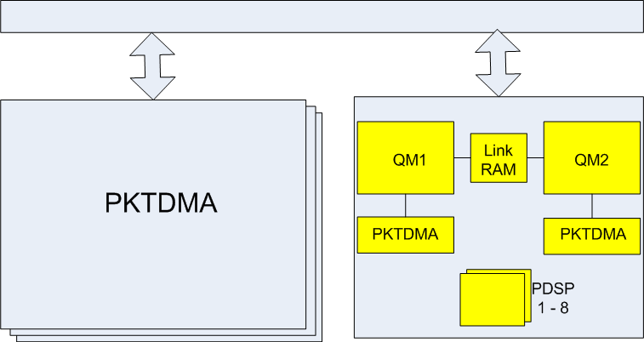
KeyStone II Multicore Navigator Architecture
TeraNet

Slide 29
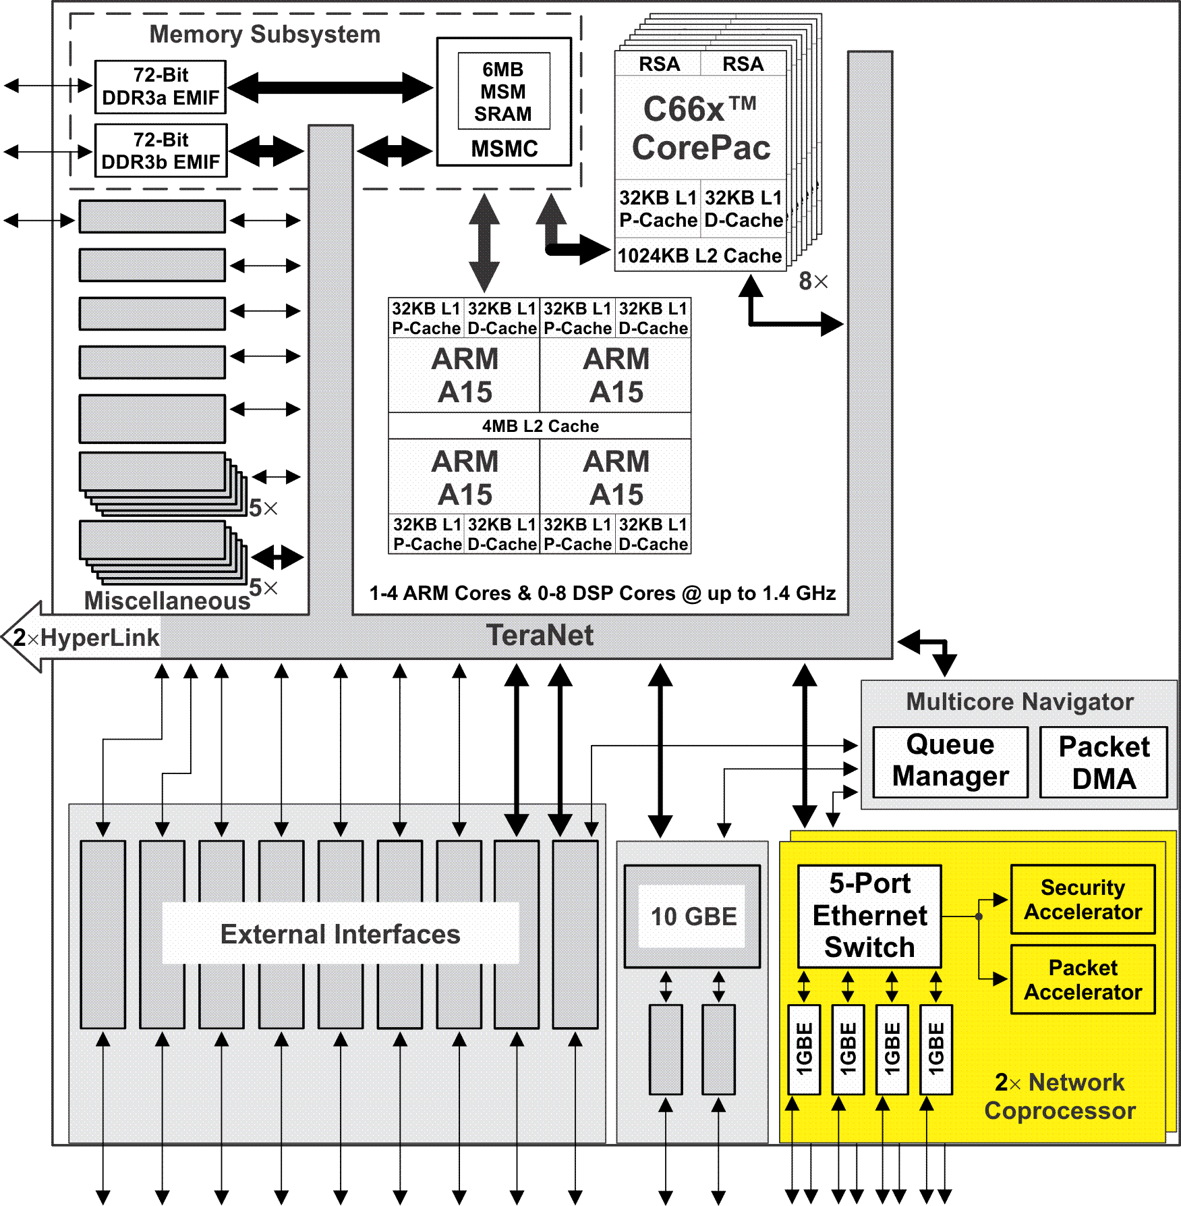
KeyStone II Network Coprocessor (NETCP)
Consists of one or two Network Coprocessor(s)
Provides hardware accelerators to perform L2, L3, and L4 processing and encryption that was previously done in software
Packet Accelerator (PA)
Single IP address option
UDP (and TCP) checksum and selected CRCs
L2/L3/L4 support
Quality of Service (QoS)
Multicast to multiple queues
Timestamps
Security Accelerator (SA)
Hardware encryption, decryption, and authentication
Supports IPsec ESP, IPsec AH, SRTP, and 3GPP protocols
2x 5-port Ethernet switches (depending on number of instances of NETCP) with 4-8 ports connecting to 4-8 SGMII ports and one port connecting to the Packet and Security Accelerators.
Notes:
29
Same as KS I except we have a 5 port switch inside the NetCP instead of a 3 port switch.
Some device variation we might have 2 instance of the netCp to increase the supported BW.
PA and SA are same.

Slide 30
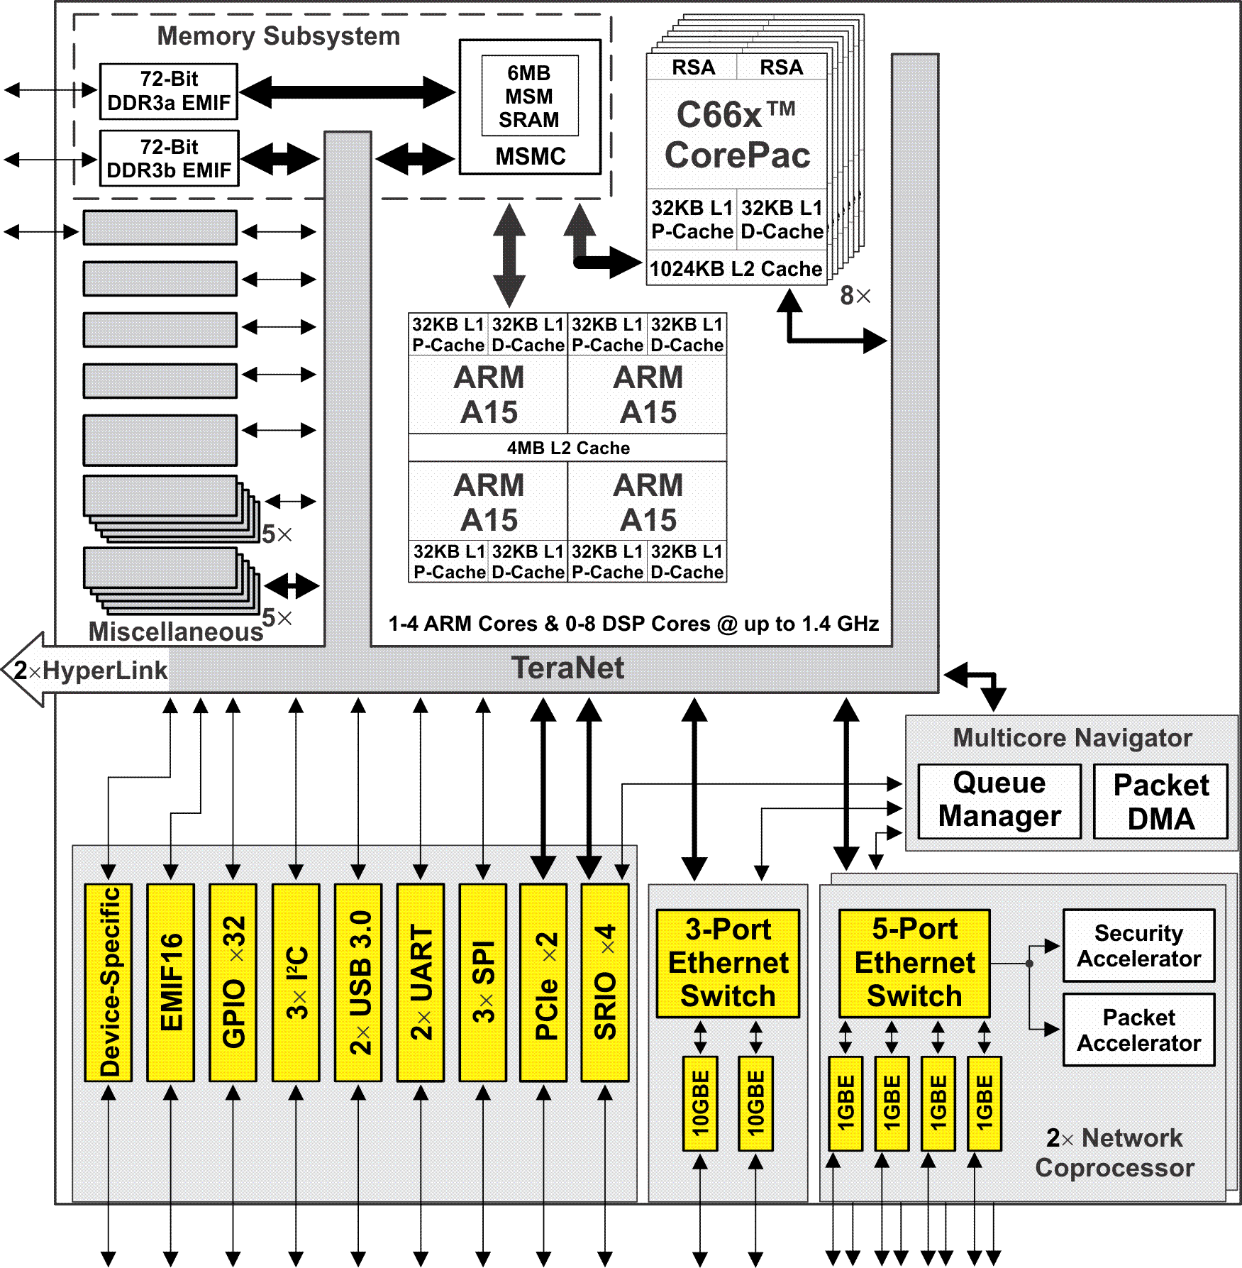
KeyStone II External Interfaces
8x SGMII ports support 10/100/1000M Ethernet through 1-2x 5-port Ethernet switch(es).
2x XGMII ports support up to 10G Ethernet through a 3-port Ethernet switch.
4x high-bandwidth Serial RapidIO (SRIO v2.1) lanes for inter-DSP applications
2x PCIe at 5 Gbps
2x USB 3.0
3x SPI modules with up to four chip selects per module.
2x UART for development/testing
3x I2C at 400 Kbps
32 GPIO pins
EMIF 16
Device-specific interfaces
Notes:
30
SGMII
XGMII
SRIO
PCIe
SPI
UART for debug.
USB – for connecting to solid state devices.
I2C
GPIO
EMIF16

Slide 31
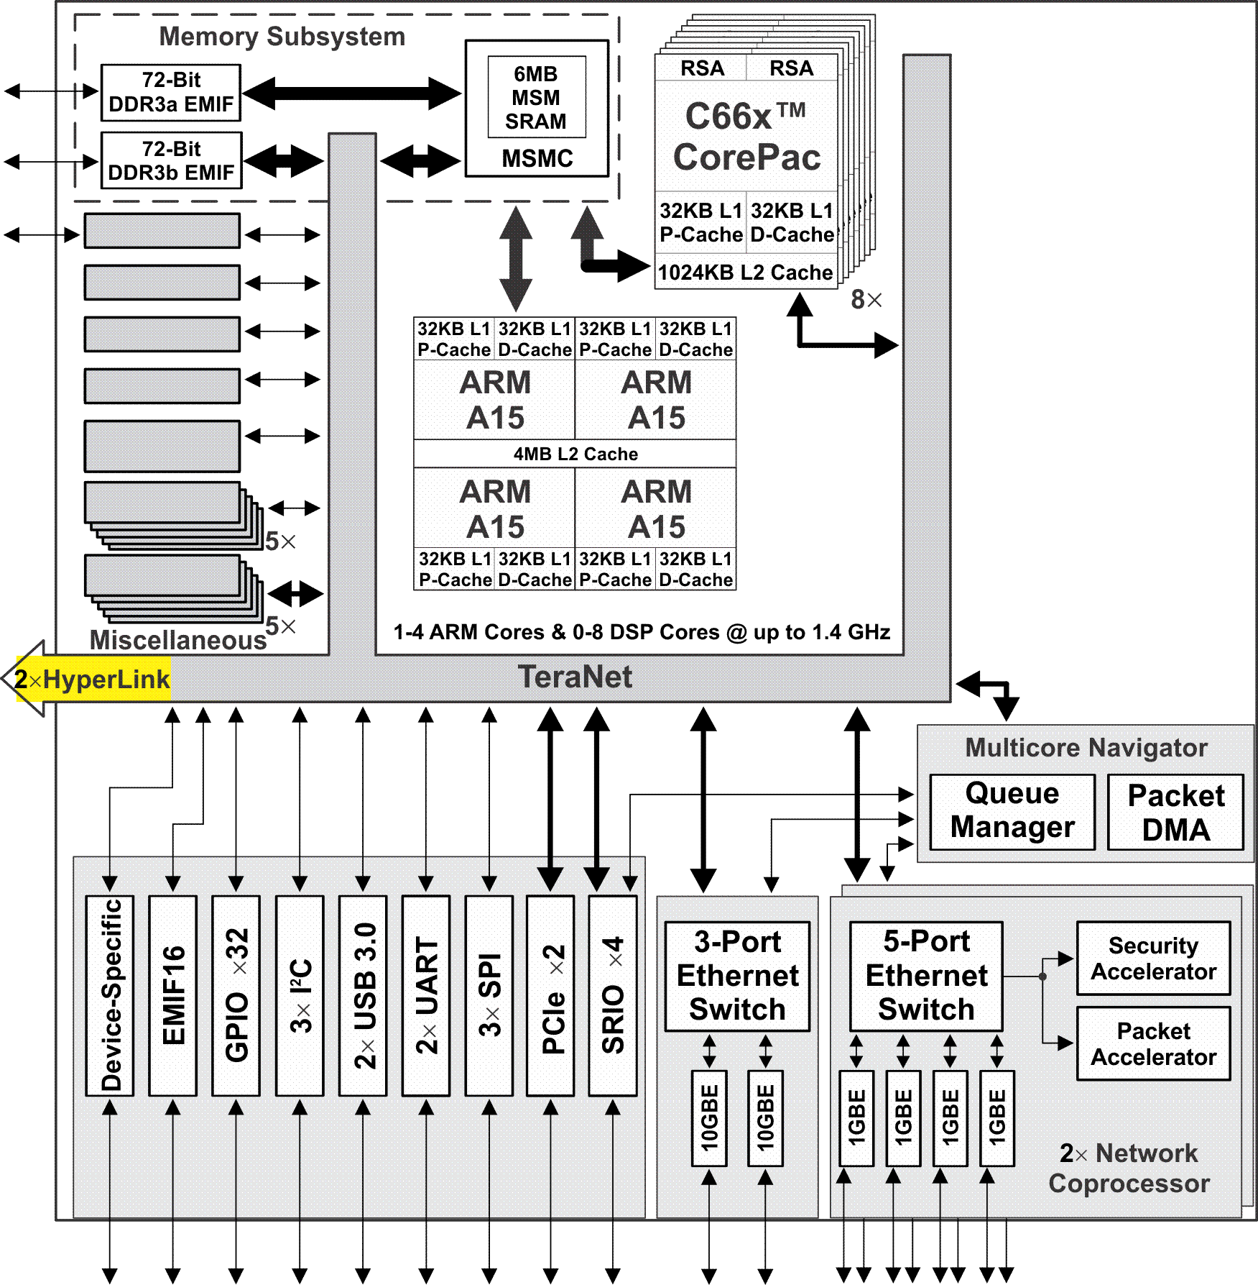
KeyStone II HyperLink Bus
Provides TI-propriety, high-speed interconnects termed HyperLink.
Up to 2x HyperLink modules with 4 lanes each.
Provides the capability to expand the device to include hardware acceleration or other auxiliary processors
Supports up to 12.5 Gbaud per lane
Notes:
31
Have two instances in some variations.
TI propriety.

Slide 32
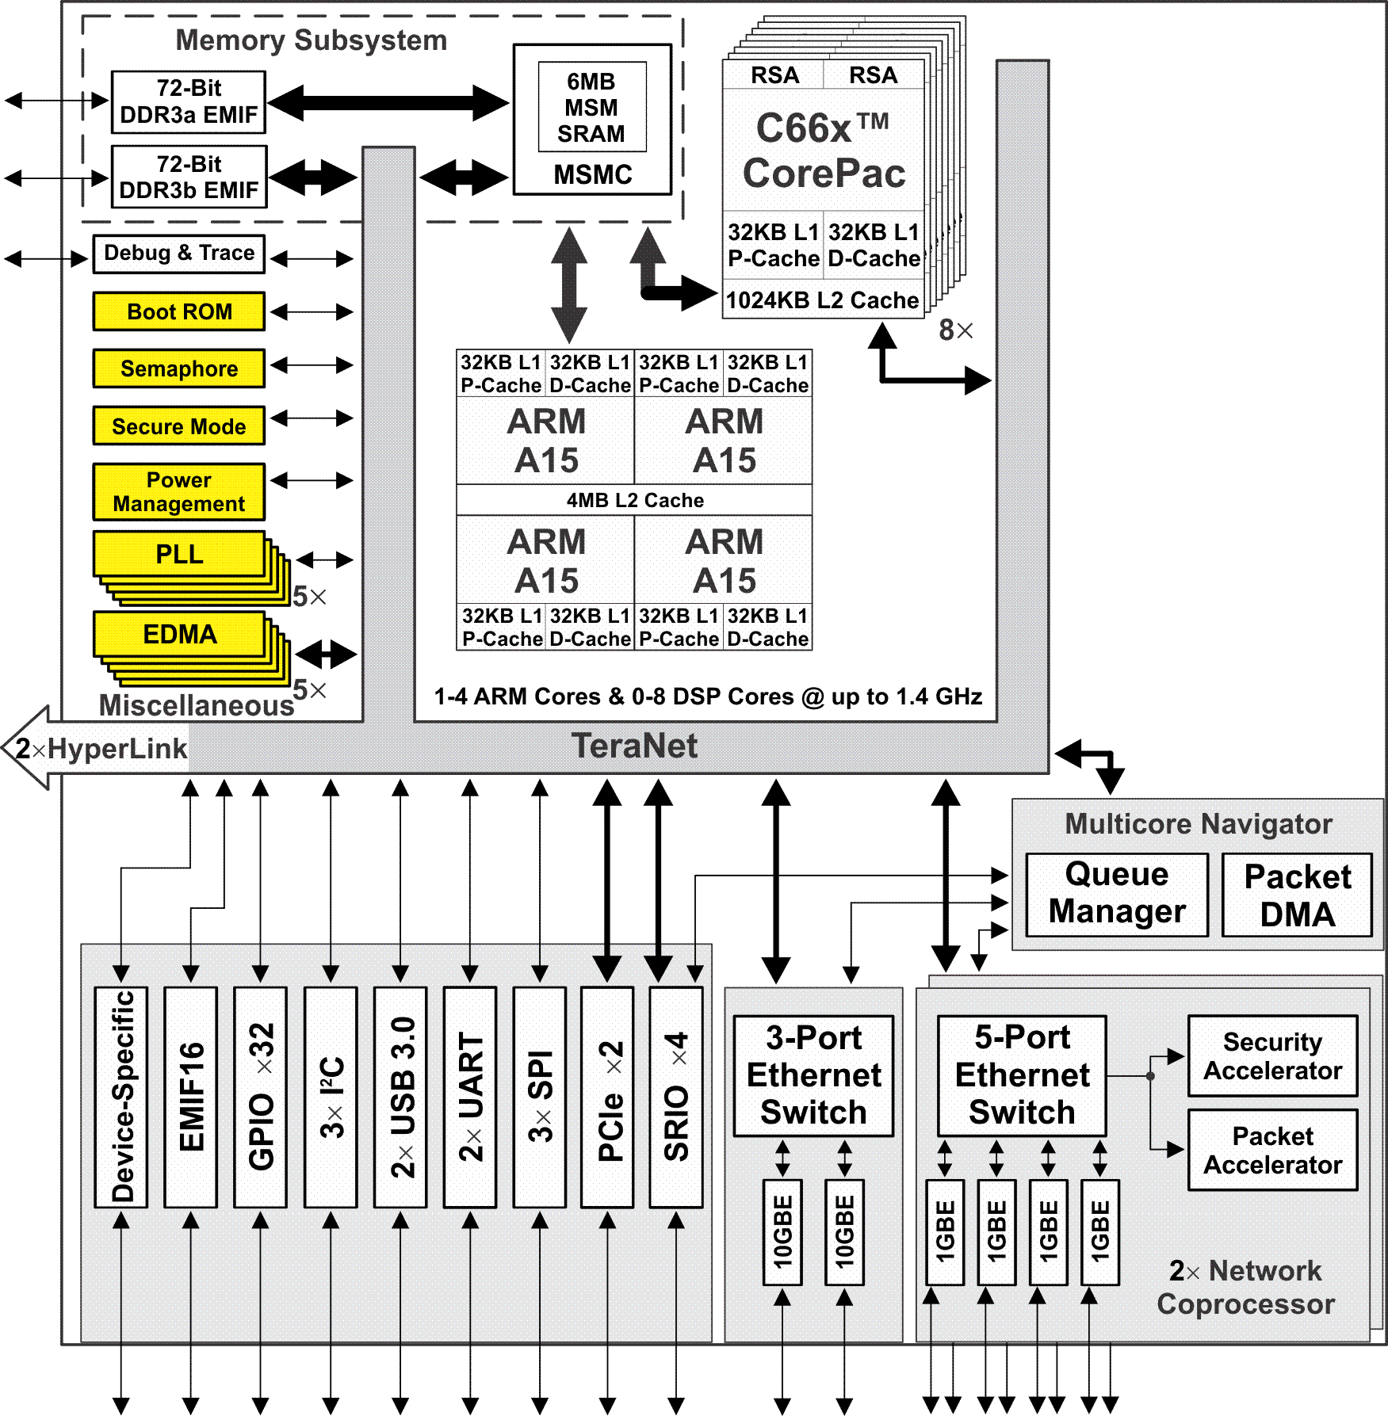
KeyStone II Miscellaneous Elements
ARM- and DSP-driven Boot ROM:
C66x CorePacs support booting from SRIO, PCIe, I2C Master, I2C Slave, SPI, Ethernet, XIP, and HyperLink.
ARM CorePacs support booting from UART, NAND, XIP, SPI, Ethernet, PCIe, I2C, SRIO and HyperLink.
Support varies by peripheral availability
Semaphore module provides atomic access to shared chip-level resources.
Secure Mode (1-time burn security key)
Power Management:
Manages power- and clock-switching of individual IPs and CorePac(s).
Supports Dynamic Power Switching (DPS):
Power-state hibernation modes 1 and 2
Manages each C66x CorePac, each ARM core, and/or the entire ARM CorePac
Reset isolation capability on select peripherals
SmartReflex Class 0 and Class 3
Up to 5 on-chip PLLs:
One Main PLL
One PLL for DDR3A
One PLL for DDR3B
One PLL for ARM CorePac
One PLL for Packet Accelerator
5x EDMA controllers
20x 64-bit timers
Inter-Processor Communication (IPC) Registers
Notes:
32
2 bootROM.
Semaphore help to manage shared memory access.
Secure Mode. – provides secure boot.
Provides access to secure memory from masters.
Disabling debug and JTAG capabilities .
One Time programming memory for customer to burn the security keys.
Power management.
PLL
Timers
IPC interrupts for core to core messaging.

Slide 33
KeyStone Platform
Device-Specific Offerings

Slide 34
Device-Specific: C6670 for Wireless Apps
Memory Subsystem
C6670
Coprocessors
Device-specific Coprocessors:
2x FFT Coprocessor (FFTC)
Turbo Decoder/Encoder Coprocessor (TCP3d/3e)
4x Viterbi Coprocessor (VCP2)
Bit-rate Coprocessor (BCP)
2x Rake Search Accelerator (RSA)
Device-specific Interfaces:
6x Antenna Interface 2 (AIF2)
64-Bit
2MB
DDR3 EMIF
MSM
SRAM
MSMC
Debug/Trace
RSA
RSA
x2
VCP2
x4
Boot ROM
Semaphore
C66x™
TCP3d
x2
Power
CorePac
Management
TCP3e
PLL
32KB L1P
32KB L1D
FFTC
x2
x3
Cache/RAM
Cache/RAM
EDMA
1024KB L2 Cache/RAM
BCP
x3
4 Cores @ 1.0 GHz / 1.2 GHz
HyperLink
TeraNet
Multicore Navigator
Queue
Packet
Manager
DMA
x2
x6
x4
t
T
e
h
C
R
I
n
c
Security
e
P
O
r
t
h
GPIO
2
I
A
S
2
e
i
c
Accelerator
I
C
U
F
I
h
w
t
P
I
R
t
S
i
A
S
E
w
S
Packet
I
Accelerator
I
M
x2
G
S
Network Coprocessor
Notes:
34
NEW

Slide 35
Device-Specific: C667x General Purpose
Memory Subsystem
C6671/C6672 C6674/C6678
Device-specific Interfaces:
2x Telecommunications Serial Port (TSIP)
Asynchronous Memory Interface (EMIF16):
Connects memory up to 256 MB
Three modes:
Synchronized SRAM
NAND flash
NOR flash
64-Bit
4MB
DDR3 EMIF
MSM
SRAM
MSMC
Debug/Trace
Boot ROM
Semaphore
C66x™
Power
CorePac
Management
PLL
32KB L1P
32KB L1D
x3
Cache/RAM
Cache/RAM
EDMA
512KB L2 Cache/RAM
x3
1 to 8 Cores @ up to 1.25 GHz
TeraNet
HyperLink
TeraNet
Multicore Navigator
Queue
Packet
Manager
DMA
6
x2
x2
x4
t
1
O
T
e
h
C
R
I
n
c
Security
F
I
e
P
P
O
r
t
h
I
P
2
I
A
S
e
i
c
Accelerator
M
G
I
C
U
I
I
h
w
t
E
P
S
R
t
S
i
T
S
E
w
S
Packet
I
Accelerator
I
M
x2
G
S
Network Coprocessor
Notes:
35
NEW

Slide 36
Device-Specific: C665x General Purpose
Memory Subsystem
1MB
C6655/57
Device-specific Coprocessors:
Turbo Decoder Coprocessor (TCP3d)
2x Viterbi Coprocessor (VCP2)
Device-specific Interfaces:
Asynchronous Memory Interface (EMIF16)
Universal Parallel Port (UPP)
2x Multichannel Buffered Serial Ports (McBSP)
Device-specific Memory:
1 MB Multicore Shared Memory (MSM SRAM)
32-bit DDR3 Interface
32-Bit
MSM
DDR3 EMIF
SRAM
MSMC
Debug/Trace
Boot ROM
2nd core, C6657 only
Semaphore
Timers
C66x™
Security /
CorePac
Key Manager
Coprocessors
Power
Management
32KB L1P
32KB L1D
TCP3d
PLL
Cache/RAM
Cache/RAM
x2
1024KB L2 Cache
VCP2
EDMA
1 or 2 Cores @ up to 1.25 GHz
x2
HyperLink
TeraNet
Multicore Navigator
Queue
Packet
Manager
DMA
x2
x2
x2
x4
O
P
T
I
Ethernet
I
P
O
MAC
EMIF16
P
I²C
R
P
e
I
G
U
A
S
McBSP
I
U
C
R
P
S
SGMII
Notes:
36
NEW

Slide 37
Device-Specific: C665x Power Optimized
Memory Subsystem
C6654
32-Bit
Device-specific Interfaces:
Asynchronous Memory Interface (EMIF16)
Universal Parallel Port (UPP)
2x Multichannel Buffered Serial Ports (McBSP)
Device-specific Memory:
32-bit DDR3 Interface
DDR3 EMIF
MSMC
Debug/Trace
Boot ROM
Semaphore
Timers
C66x™
Security /
CorePac
Key Manager
Power
Management
32KB L1P
32KB L1D
PLL
Cache/RAM
Cache/RAM
x2
1024KB L2 Cache
EDMA
1 Core @ 850 MHz
TeraNet
Multicore Navigator
Queue
Packet
Manager
DMA
x2
x2
x2
O
P
T
I
P
Ethernet
I
P
S
MAC
EMIF16
P
I²C
R
P
e
G
U
A
S
B
I
U
c
C
M
P
SGMII
Notes:
37
NEW

Slide 38
KeyStone C665x: Key HW Variations
HW Feature | C6654 | C6655 |  | C6657
CorePac Frequency (GHz) | 0.85 | 1 @ 1.0, 1.25 | 2 @ 0.85, 1.0, 1.25
Multicore Shared Memory (MSM) | No | 1024KB SRAM
DDR3 Maximum Data Rate | 1066 | 1333
Serial Rapid I/O Lanes | No | 4x
HyperLink | No | Yes
Viterbi Coprocessor (VCP) | No | 2x
Turbo Coprocessor Decoder (TCP3d) | No | Yes
Network Coprocessor (NETCP) | No | No

Slide 39
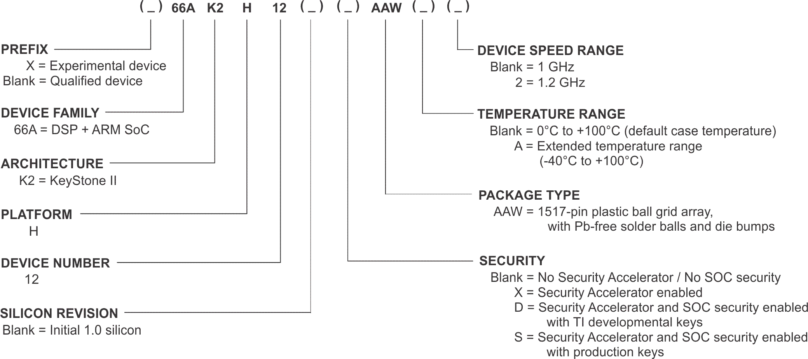
KeyStone II Part Numbering

Slide 40
K2H (K2K) Compared to K2E
Platform | C66x DSP | ARM A15 | Max Clock Ghz | MSMC Shared Memory – MB | Navigator Queues | DDR3 EMIF 72-bit 1600 MT/s | 5-Port 1GB Switch | 3-Port 10GB Switch | USB 3.0 | HyperLink | SRIO x4 | PCIe x2 | TSIP
K2E | 0x to 1x | 1x to 4x | ARM = 1.4 DSP = 1.4 | 2 | 8K | 1x | 1x to 2x | 2x | 2x | 1x | -- | 2x | 1x
K2H | 4x to 8x | 2x to 4x | ARM = 1.4 DSP = 1.2 | 6 | 16K | 2x | 1x | -- | 1x | 2x | 1x | 1x | --

Slide 41
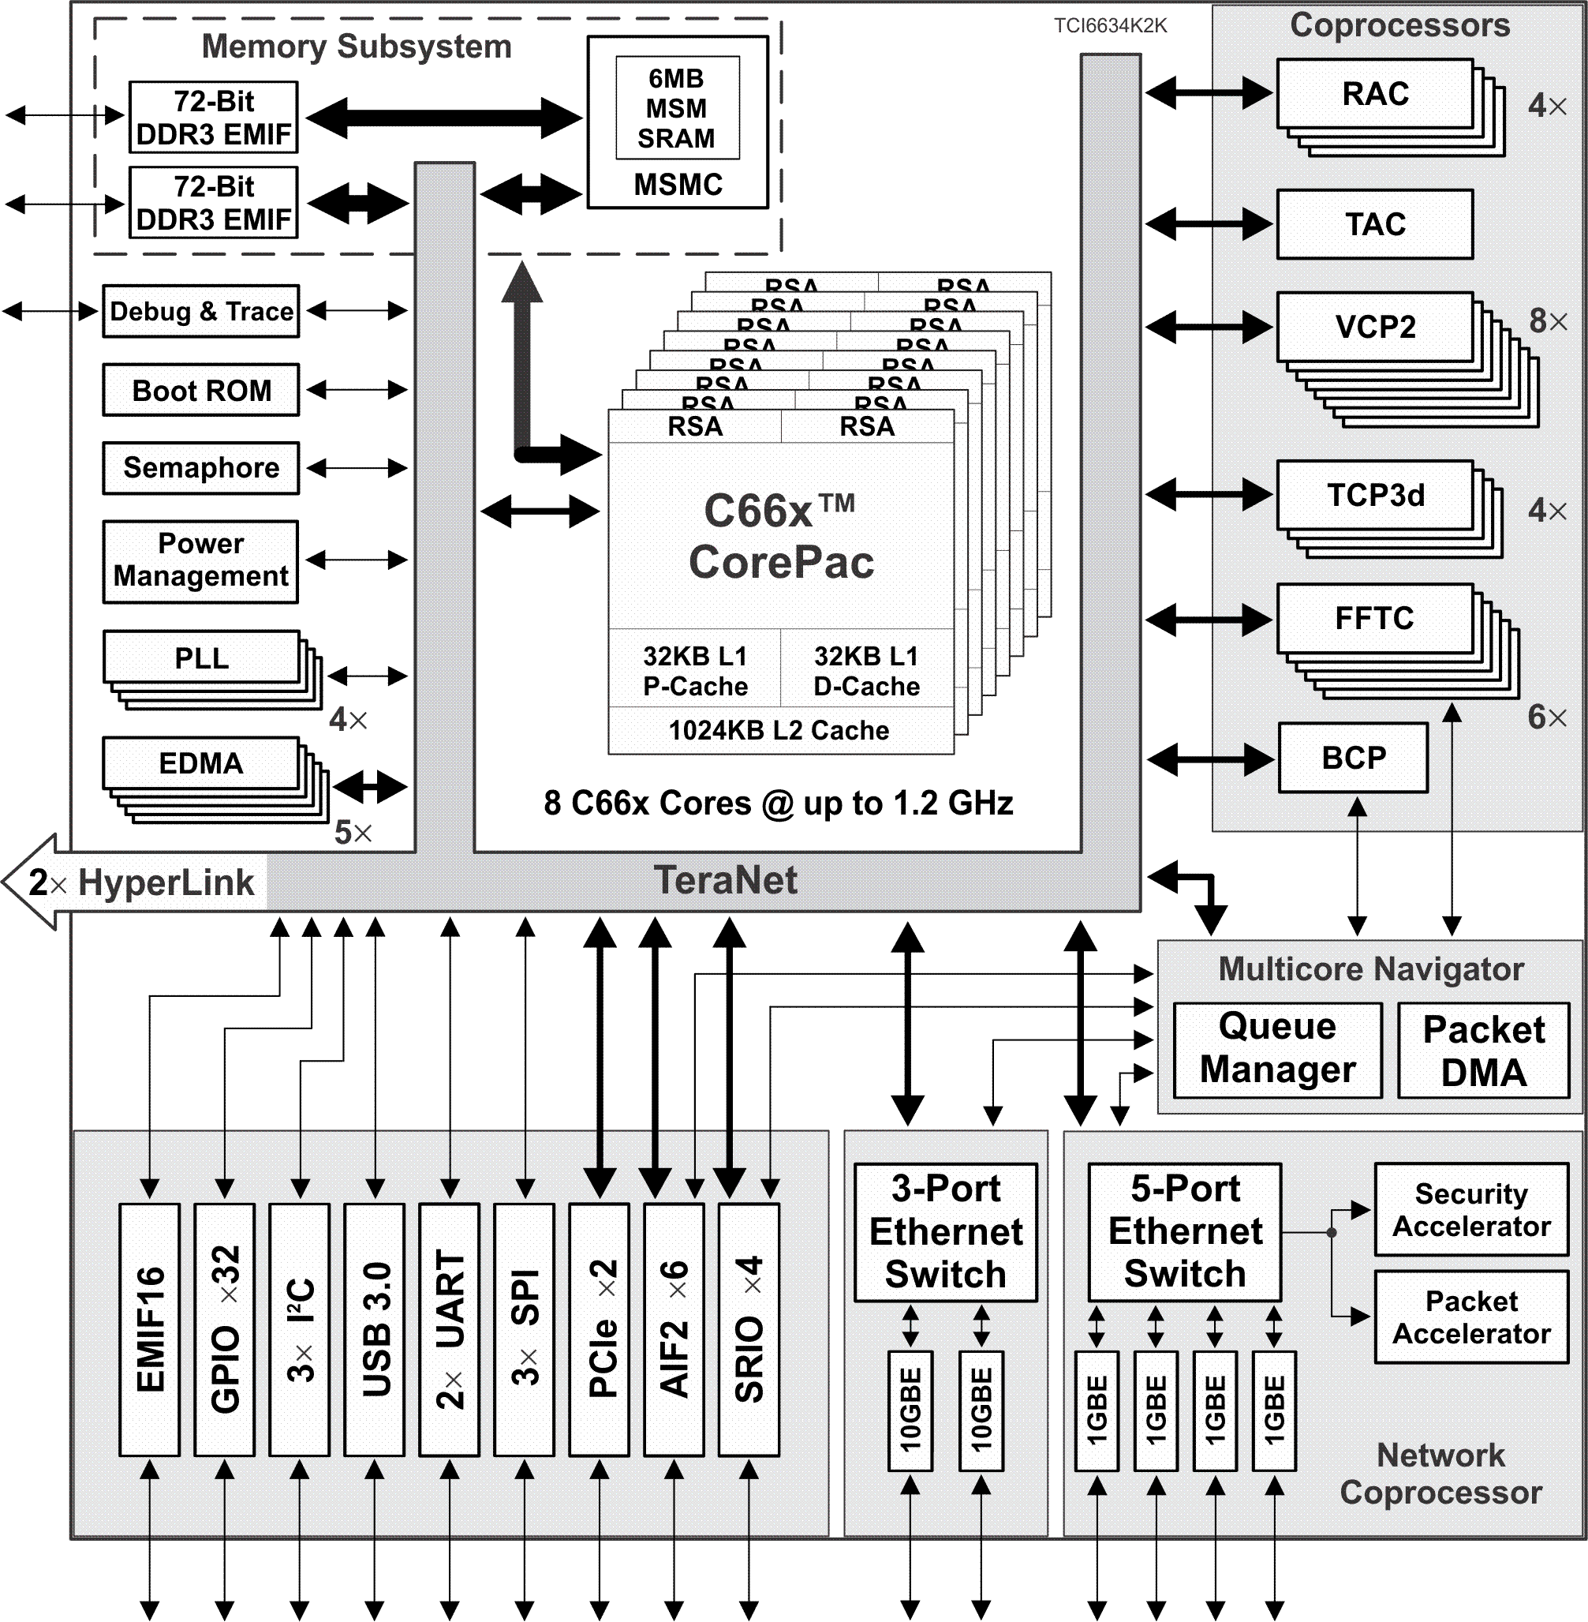
K2K Platform Device Variations
The K2K platform has two variations:
TCI6634K2K
8x C66x CorePacs
16x Rake/Search Accelerators (RSA)
2x Queue Managers support up to 16K queues
1x USB3.0 to support solid state drive
6x Antenna Interface 2 (AIF2)
1x 3 port 10GBE Switch Subsystem
1x Network Coprocessor (NETCP)
4x Receive Acceleration Coprocessors (RAC)
Transmit Acceleration Coprocessor (TAC)
4x Turbo Decoder/Encoder Coprocessors (TCP3d/3e)
8x Viterbi Coprocessors (VCP2)
6x FFT Coprocessors (FFTC)
Bit-rate Coprocessor (BCP)
Notes:
41
NEW

Slide 42
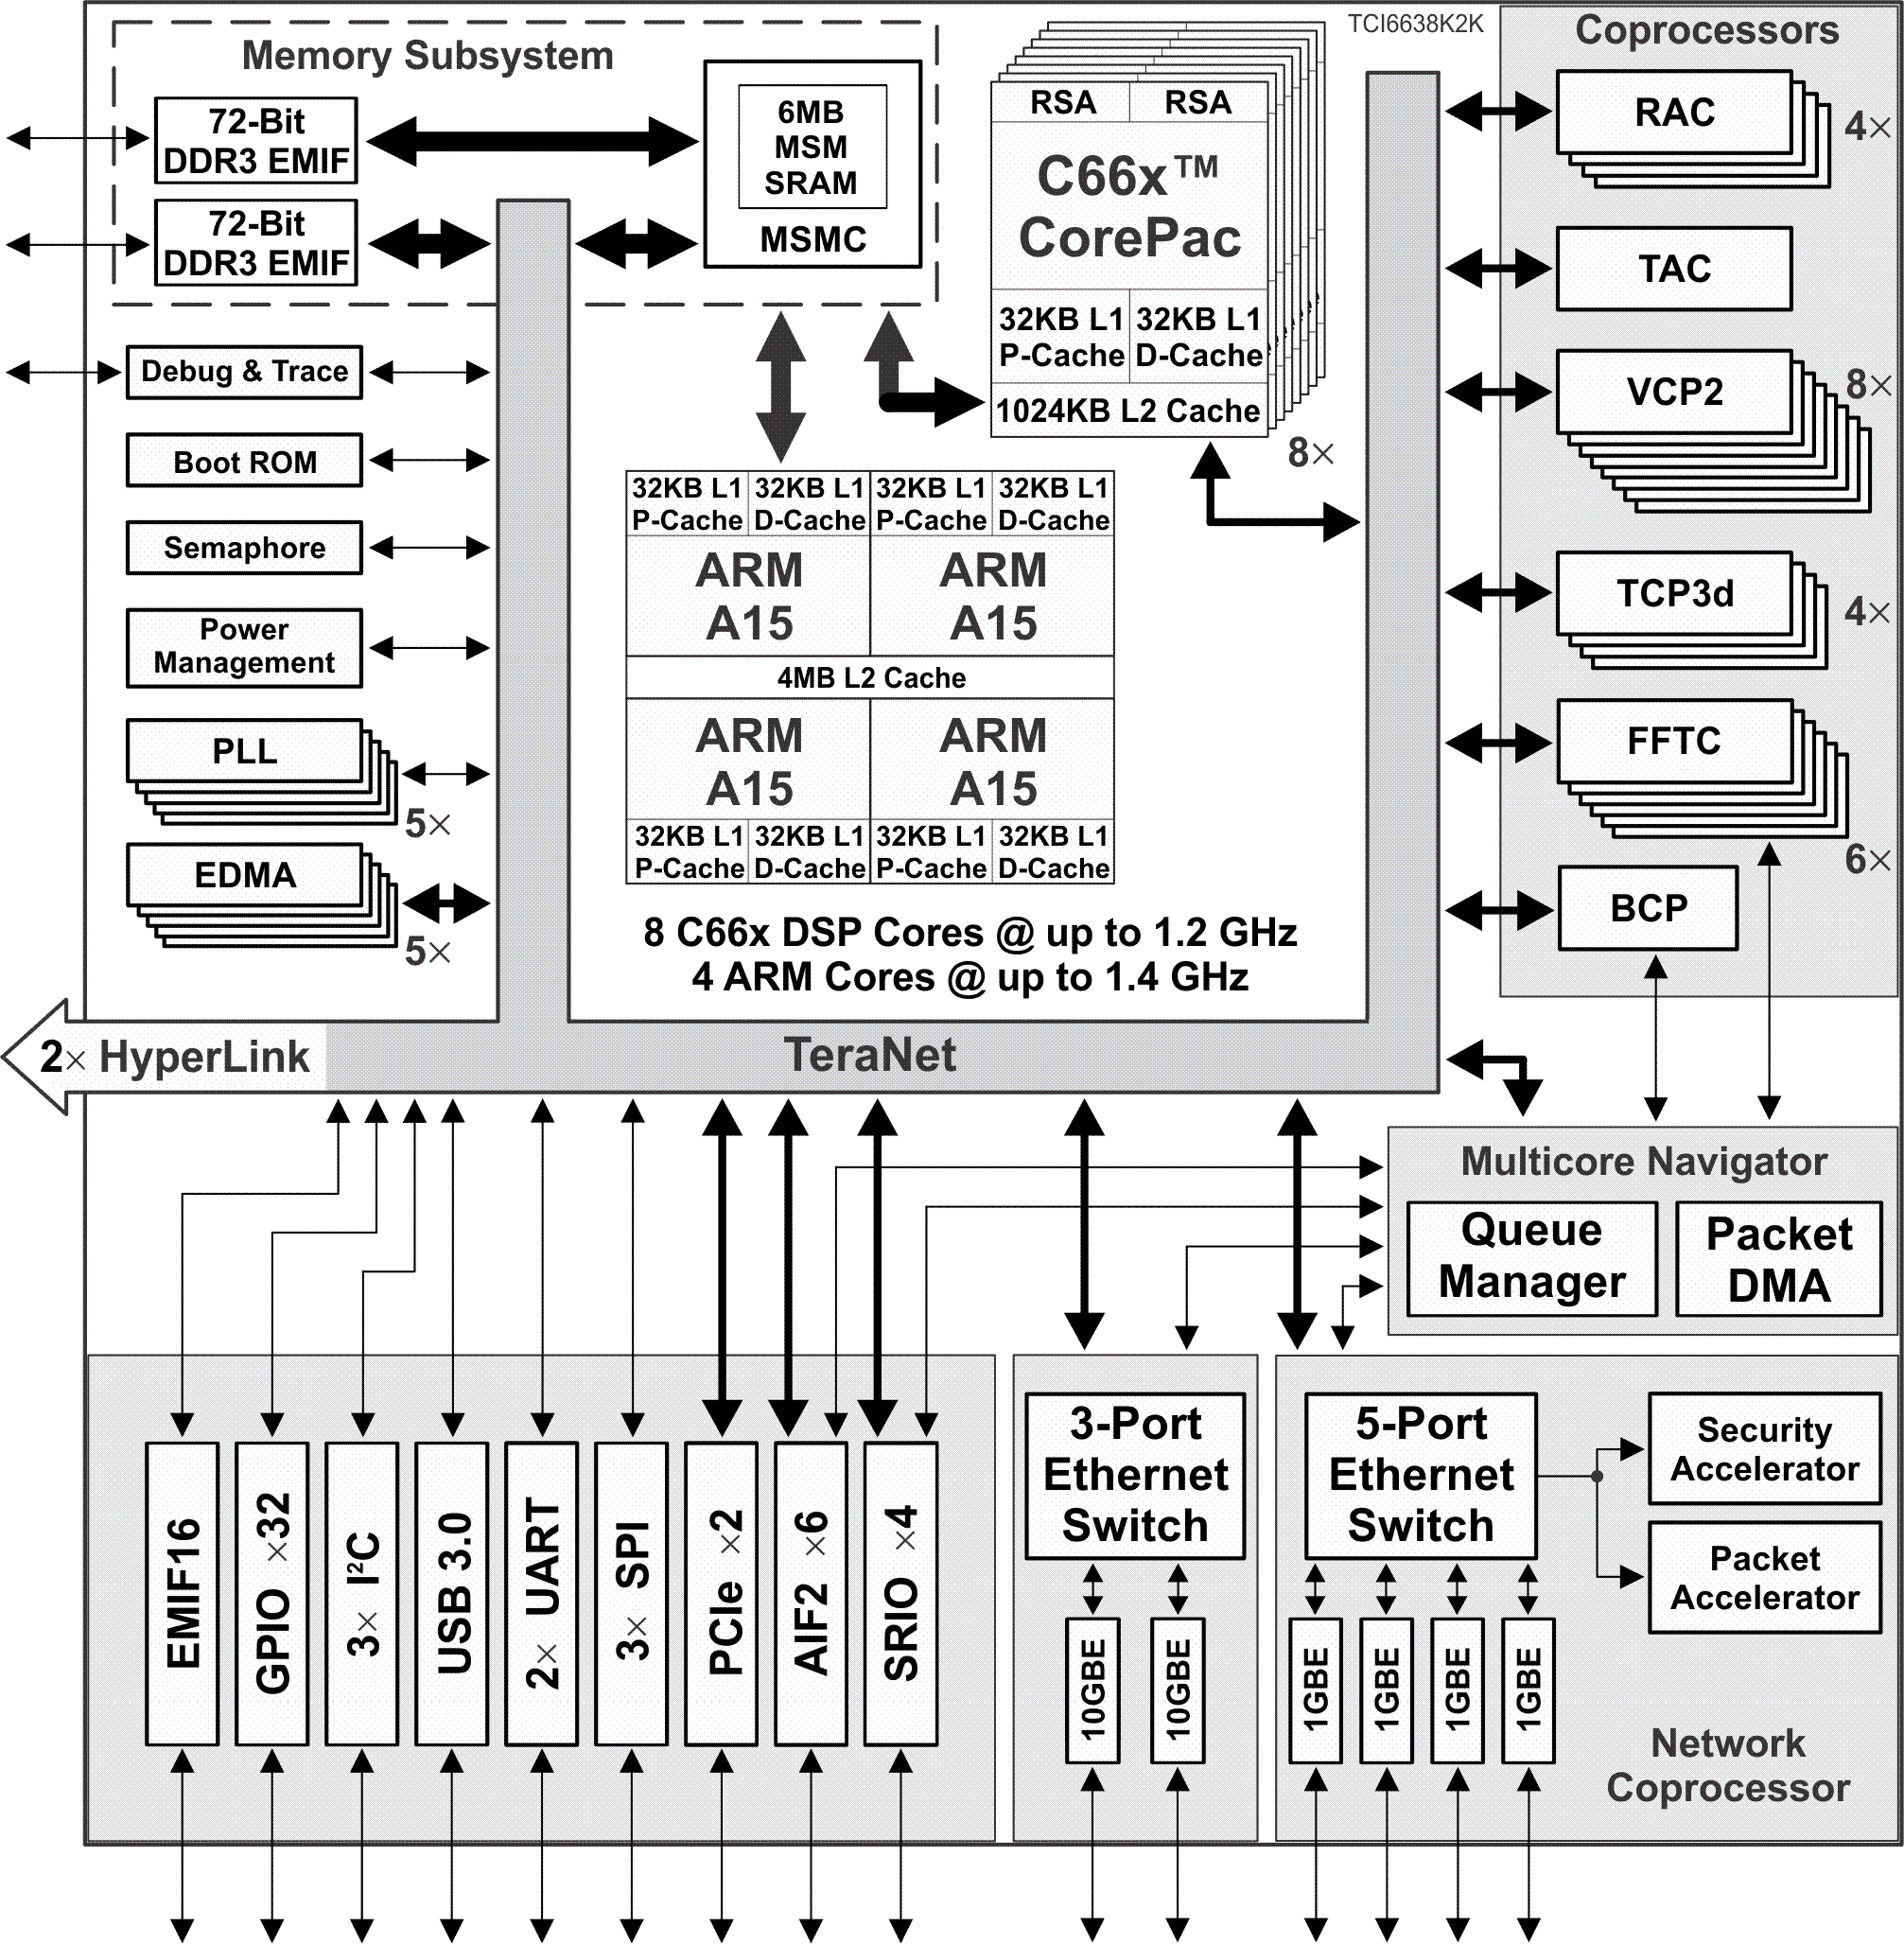
K2K Platform Device Variations
The K2K platform has two variations:
TCI6634K2K
8x C66x CorePacs
16x Rake/Search Accelerators (RSA)
2x Queue Managers support up to 16K queues
1x USB3.0 to support solid state drive
6x Antenna Interface 2 (AIF2)
1x 3 port 10GBE Switch Subsystem
1x Network Coprocessor (NETCP)
4x Receive Acceleration Coprocessors (RAC)
Transmit Acceleration Coprocessor (TAC)
4x Turbo Decoder/Encoder Coprocessors (TCP3d/3e)
8x Viterbi Coprocessors (VCP2)
6x FFT Coprocessors (FFTC)
Bit-rate Coprocessor (BCP)
TCI6638K2K
Same as TCI6634K2K plus …
Quad-ARM A15 CorePac
Notes:
42
NEW

Slide 43
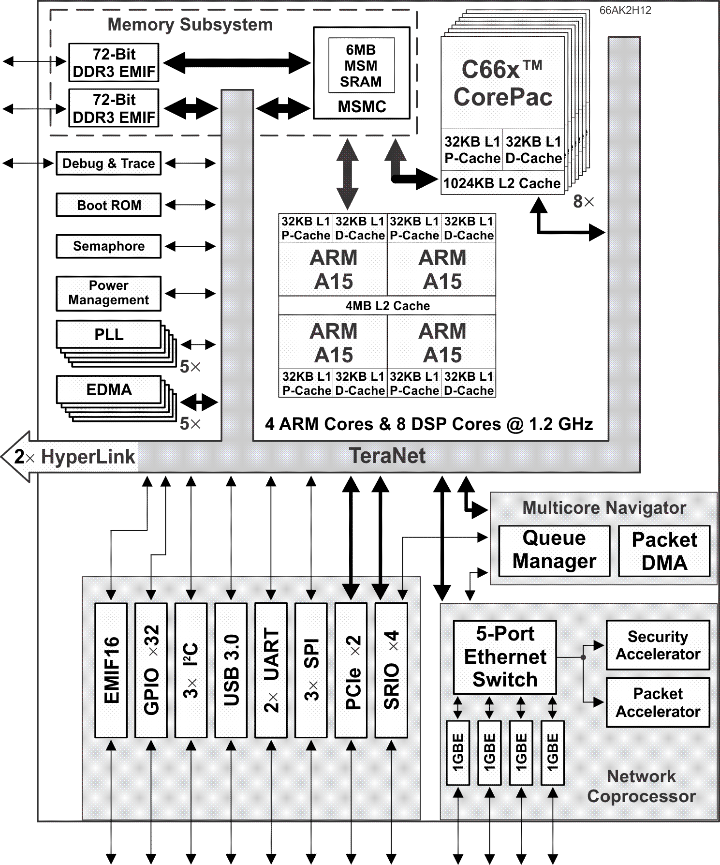
K2H Platform Device Variations
The K2H platform has two variations:
66AK2H12
8x C66x CorePacs
Quad-ARM A15 CorePac
2x Queue Managers support up to 16K queues
1x Network Coprocessor (NETCP)
1x USB3.0 to support solid state drive
10GBE interface is NOT available.
Notes:
43
NEW

Slide 44
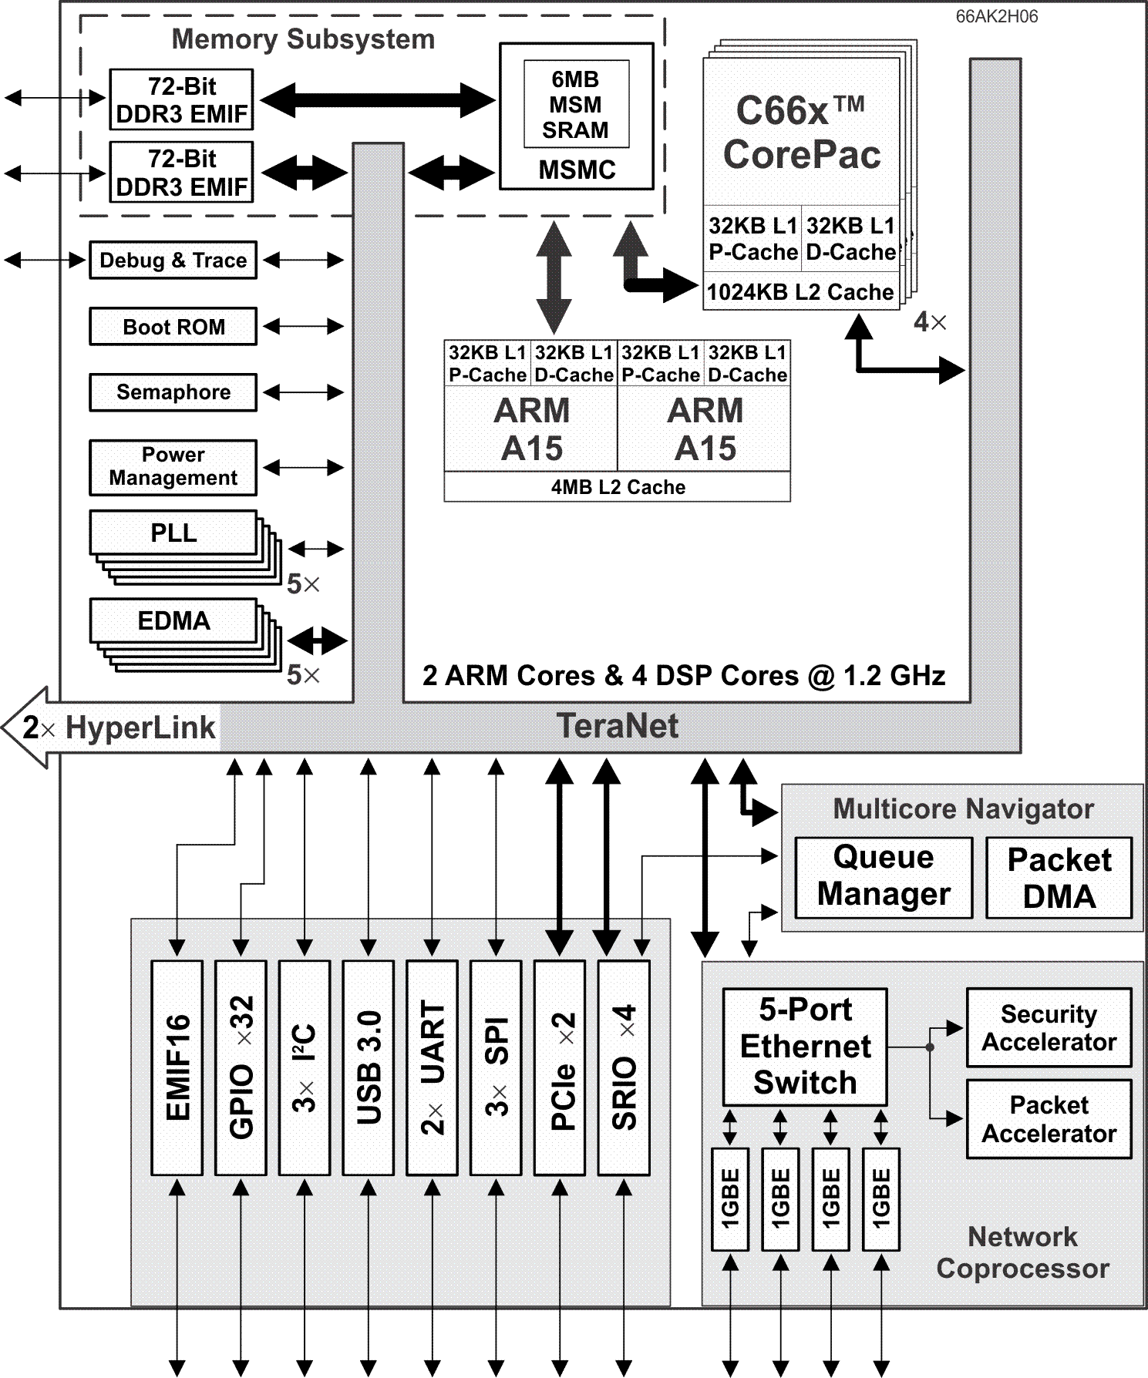
K2H Platform Device Variations
The K2H platform has two variations:
66AK2H12
8x C66x CorePacs
Quad-ARM A15 CorePac
2x Queue Managers support up to 16K queues
1x Network Coprocessor (NETCP)
1x USB3.0 to support solid state drive
10GBE interface is NOT available
66AK2H06
Scaled-down version of 66AK2H12
4x C66x CorePacs
Dual-ARM A15 CorePac
Notes:
44
NEW

Slide 45
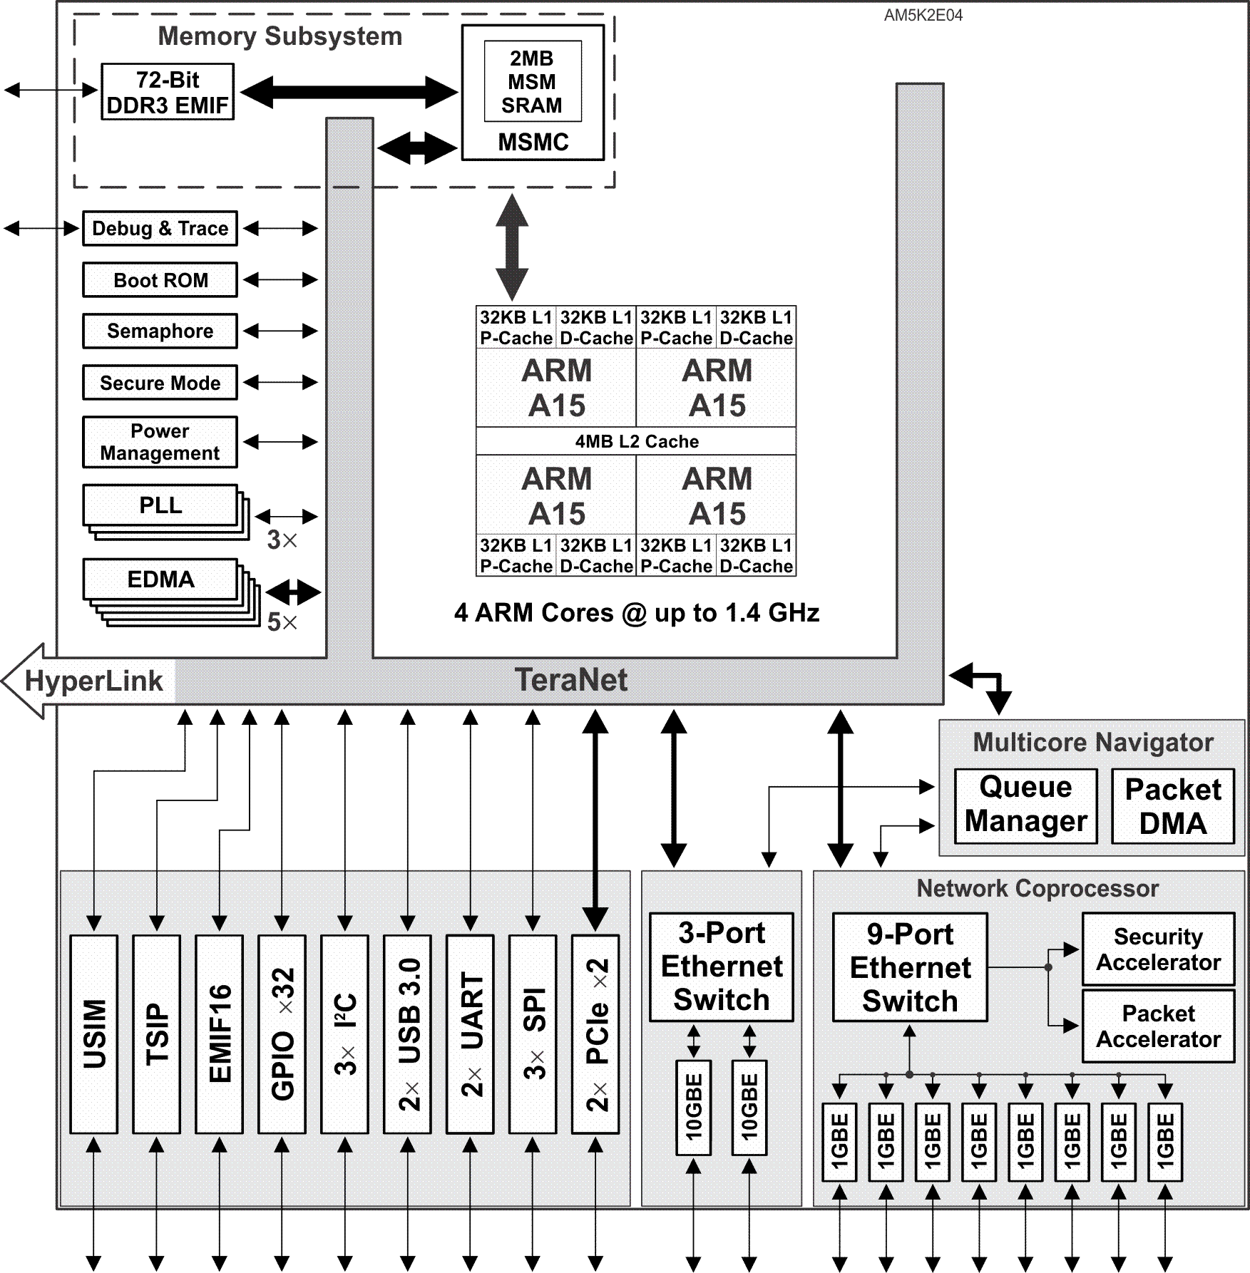
K2E Platform Device Variations
The K2E platform has four variations:
AM5K2E04
First ARM-only TI multicore device
Quad-ARM A15 CorePac
1x Queue Manager supports up to 8K queues
1x Network Coprocessors (NETCP)
1x 3 port 10GBE Switch Subsystem
Telecommunications Serial Port (TSIP)
2x USB 3.0 to support solid state drive
No SRIO
Notes:
45
NEW

Slide 46
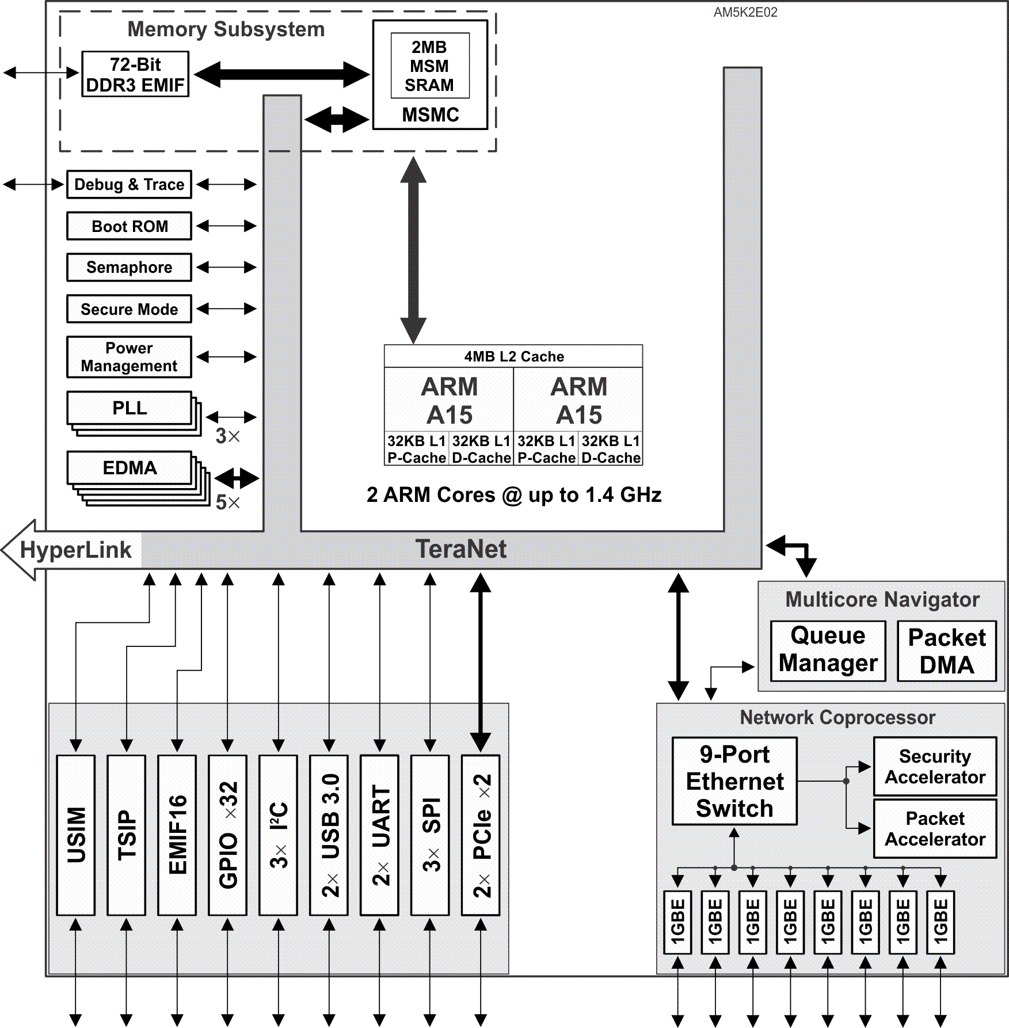
K2E Platform Device Variations
The K2E platform has four variations:
AM5K2E04
First ARM-only TI multicore device
Quad-ARM A15 CorePac
1x Queue Manager supports up to 8K queues
1x Network Coprocessors (NETCP)
1x 3 port 10GBE Switch Subsystem
Telecommunications Serial Port (TSIP)
2x USB 3.0 to support solid state drive
No SRIO
AM5K2E02
Scaled-down version of AM5K2E04
Dual-ARM A15 CorePac
1x Network Coprocessor
10GBE not included
Notes:
46
NEW

Slide 47
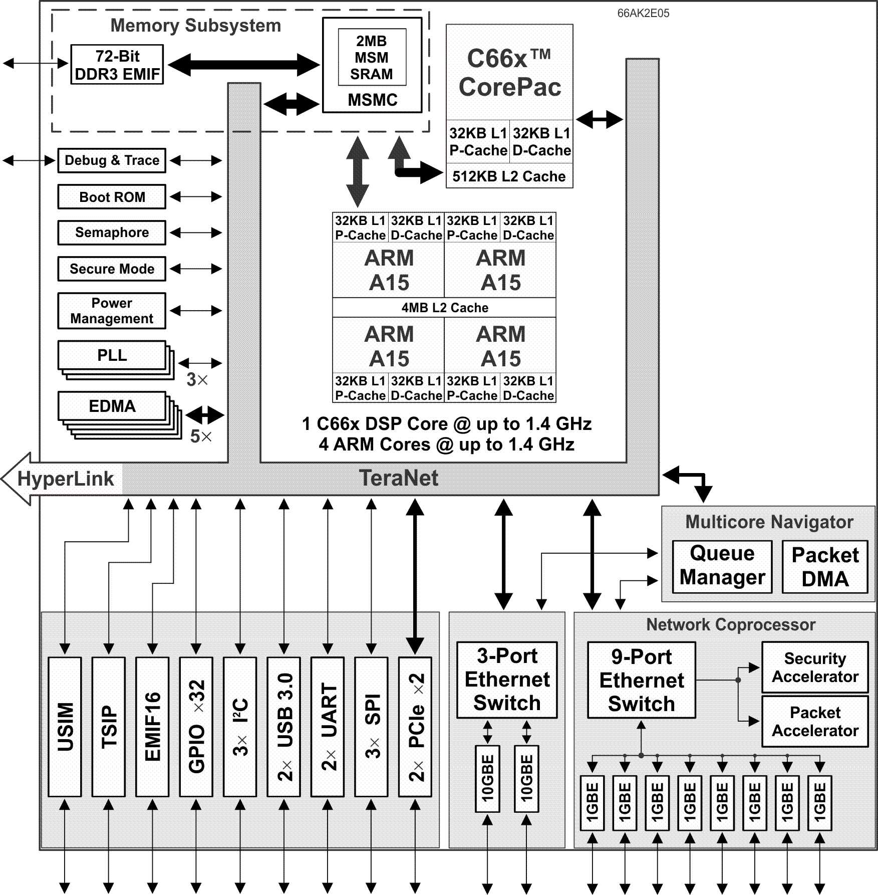
K2E Platform Device Variations
The K2E platform has four variations:
AM5K2E04
First ARM-only TI multicore device
Quad-ARM A15 CorePac
1x Queue Manager supports up to 8K queues
1x Network Coprocessors (NETCP)
1x 3 port 10GBE Switch Subsystem
Telecommunications Serial Port (TSIP)
2x USB 3.0 to support solid state drive
No SRIO
AM5K2E02
Scaled-down version of AM5K2E04
Dual-ARM A15 CorePac
1x Network Coprocessor
10GBE not included
66AK2E05
Same as AM5K2E04 with a single C66x CorePac added
Notes:
47
NEW

Slide 48
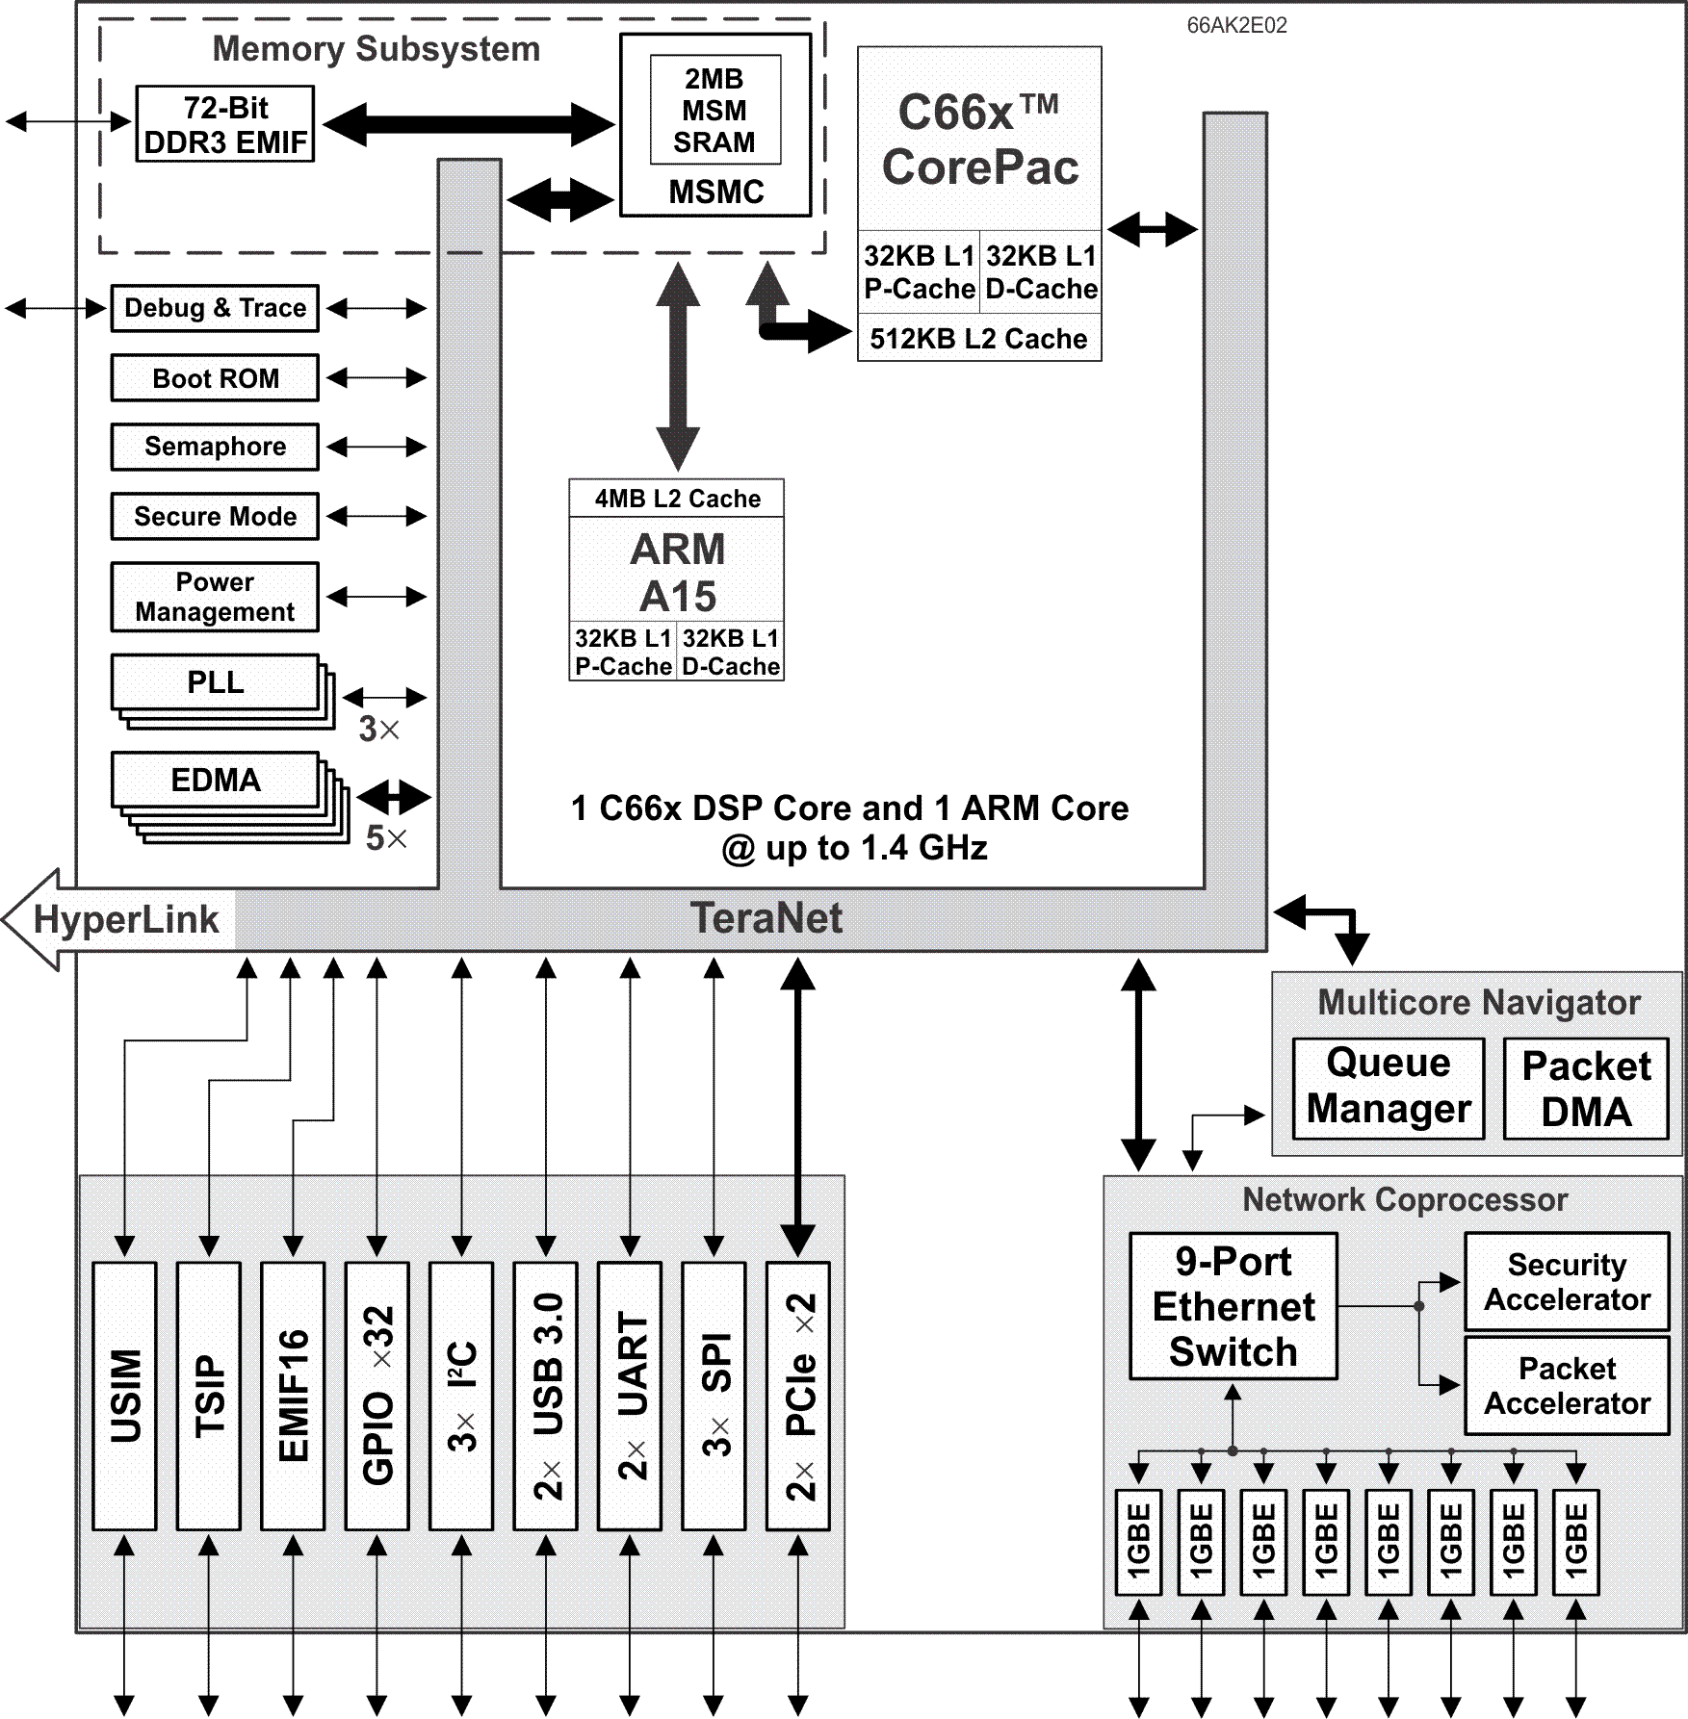
K2E Platform Device Variations
The K2E platform has four variations:
AM5K2E04
First ARM-only TI multicore device
Quad-ARM A15 CorePac
1x Queue Manager supports up to 8K queues
1x Network Coprocessors (NETCP)
1x 3 port 10GBE Switch Subsystem
Telecommunications Serial Port (TSIP)
2x USB 3.0 to support solid state drive
No SRIO
AM5K2E02
Scaled-down version of AM5K2E04
Dual-ARM A15 CorePac
1x Network Coprocessor
10GBE not included
66AK2E05
Same as AM5K2E04 with a single C66x CorePac added
66AK2E02
Same as AM5K2E02 except with a single-ARM A15 CorePac and a single C66x CorePac added
Notes:
48
NEW

Slide 49
KeyStone I Compared to KeyStone II
IP block | KeyStone I | KeyStone II
ARM Cortex-A15 core | No | 4x
MSMC | Ver1.0 | Ver2.0
DDR3 EMIF (64-bit) | 1x | 2x
MSMC SRAM | 2 Mbytes | 6 Mbytes
DDR3A memory (max) | 8 Gbytes | 8 Gbytes
DDR3B memory (max) | No | 2 Gbytes (for ARM and DSP cores) 512 Mbytes (system masters)
ARM Boot ROM | No | 256 Kbytes
OTP memory | No | 4 Kbits
Queue Manager Subsystem + PKTDMA | 1x | 2x
EDMA3CC | 3x | 5x
EDMA3TC | 10x | 14x
HyperLink | 1 x 4 | 2 x 4
10 Gigabit Ethernet (10GBE) | No | 1 x 2
UART | 1x | 2x
SPI | 1x | 3x
I2C | 1x | 3x
GPIO | 1x 16 | 1x 32
Timer64 | 8x | 20x
USB3 | No | 1x to 3x
PLL controller + On-chip PLLs | 3x | 5x
ARM Subsystem ETB (16 KB) | No | 1x
DSP TETB (4 KB) | 4x | 8x
Tracer | 16x | 32x
MPU | 6x | 15x
Security Manager | No | 1x

Slide 50
For More Information
Device-specific Data Manuals for the KeyStone SoCs can be found at TI.com/multicore.
Multicore articles, tools, and software are available at Embedded Processors Wiki for the KeyStone Device Architecture.
View the complete C66x Multicore SOC Online Training for KeyStone Devices, including details on the individual modules.
For questions regarding topics covered in this training, visit the support forums at the TI E2E Community website.

